Slide 1
Kent Nordström
Blog: http://konab.com
Twitter: http://twitter.com/kentnordstrom
Notes:
My name is Kent Nordström and you will find my blog at konab.com and I know many of you are already following me on Twitter.

Slide 2
Topic
FIM 2010 R2
codeless
(or less-code)
deployments
Notes:
Todays topic is about doing codeless or at least less-code deployments of FIM.
Since managing code is quite expensive over time I am often today asked to minimize the amount of managed code and go for the Customize Before Code principle in my deployments.
If code is needed I also try to make it available to a larger part of the FIM management team by, for example, rather using PowerShell then C#

Slide 3
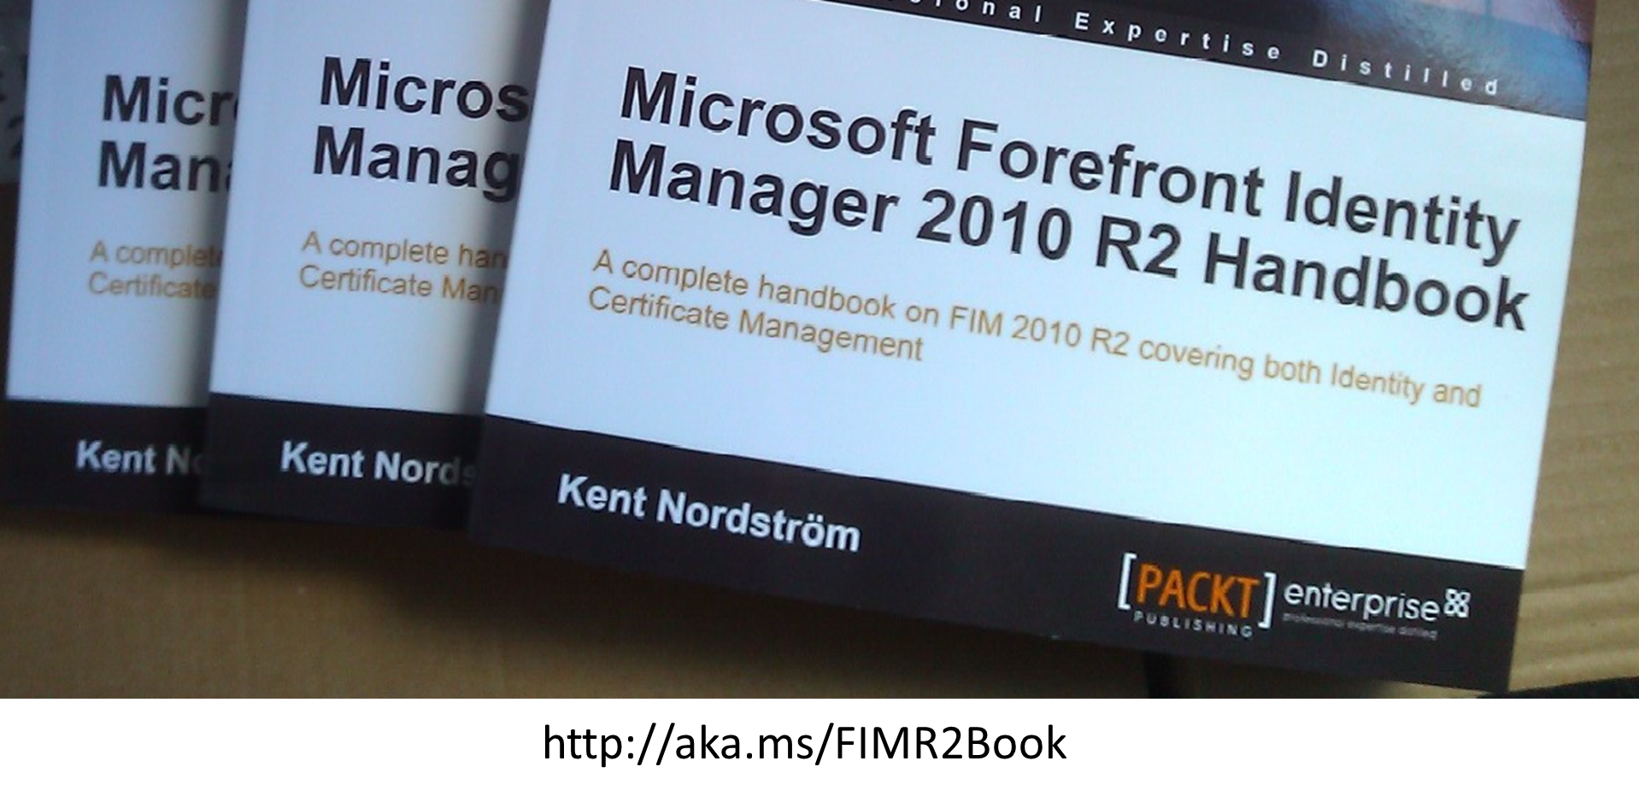
FIM 2010 R2 Handbook
Notes:
In 2012 I released the FIM 2010 R2 handbook. If you have read it you already know that this book is very much about how to build FIM 2010 R2 solutions as codeless as possible.

Slide 4
History
MIIS/ILM “All” logic built using Visual Studio
Case "user:description"
Dim description As String = String.Empty
If mventry("inetUserStatus").IsPresent Then
description = mventry("inetUserStatus").Value
Else
description = "missing"
End If
FIM 2010 Declarative Synchronization Rules
Declarative Provisioning
IIF(companyActive,
IIF(IsPresent(companyUAC),BitAnd(9223372036854775805,companyUAC),512),
IIF(IsPresent(companyUAC),BitOr(2,companyUAC),514)) → userAccountControl
Notes:
Before we dig into details I think we should spend a few seconds on the history.
In MIIS and ILM we did almost all logic using rules extensions and MetaVerse extensions.
The fact was that if you wanted provisioning, you were required to at least write an MV-extension.
When FIM 2010 came along allowing us to do some declarative rules many of us “oldies” stick’ed to our code since it was so familiar.
The fact that Microsoft also made it illegal to use the declarative way without buying the FIM CAL, did not make it easier.
But that fact is that the functions, available in synchronization rules, covers a large percentage of the logic we did using code earlier.

Slide 5
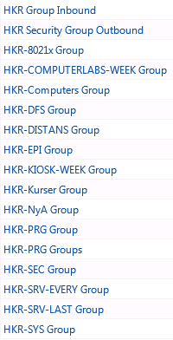
Synchronization Rules
“Kent’s Best Practices”
NO ERE’s and DRE’s
Multiple Outbound rules to avoid complex IIF logic
Rule 1: Common user attributes
Rule 2: Provisioning Employee
Rule 3: Provisioning Students
Notes:
So what about using Synchronization Rules? Here are some of my personal best-practices.
No EREs and DREs, avoid them at all cost I would say. In early FIM 2010 R1 solutions this was the only option for outbound rules but I am happy to say I have migrated away from them at almost all my customers. We will discuss de-provisioning later as well as DRE replacements.
I do not hesitate to create multiple Outbound Rules to avoid complex IF-logic even if the Outbound Rule only contains one single flow. I typically have one for common attributes with no Provisioning, and then separate rules using outbound scope filtering that defines the provisioning details. The image shows a customer case where I have 17 rules just to manage different kinds of groups in AD. One inbound and 16 outbound rules.

Slide 6
Synchronization Rules – cont.
“Kent’s Best Practices”
CustomExpression rather than UI function builder
RulesExtensions
Shared DLL: CompanyRulesExtension.dll Flow rule name: MA:ObjectType:TargetAttribute
Type conversions DateTime dtFileTime = DateTime.FromFileTime(csentry["lastLogonTimestamp"].IntegerValue); mventry["companyLastLogon"].Value = dtFileTime.ToUniversalTime().ToString("yyyy'-'MM'-'dd'T'HH':'mm':'ss'.000'");
MultiValue attributes if (csentry["proxyAddresses"].IsPresent) {if(csentry["proxyAddresses"].Values.Contains("SMTP:" + mventry["email"].Value.ToLower())) {break;} }else {csentry["proxyAddresses"].Values.Add("SMTP:" + mventry["email"].Value.ToLower());}
Notes:
In almost all my synchronization rules where I use some functions or concatenations I use the custom expression instead of building using the UI function builder. The reason is that modifications are much easier and I find it easier to “read” and understand when opening the rule. The UI can be used to get you started on how to use a specific function but then I move it into a custom expression when done.
Nested IF functions, like the one we saw earlier, are anyhow almost impossible to get correctly configured when using the UI function builder.
We need to remember that RulesExtensions are still the best solution for some scenarios. For example when working with Type conversions and MultiValue attributes like proxyAddresses.
I have however started to use a single rules extension dll shared among all MA’s to keep it as simple as possible. With the proper Flow Rule Names it is still easy to keep them apart.

Slide 7
Boolean flags
MA1: Inbound
InMA1 = true
AllObjects MA : Inbound
InMA1 = false
Synchronization Rule
IIF(InMA1),…
Scoping Filter
InMA1 equal true
Notes:
An important thing in order to make declarative synchronization easy is to add boolean flags to the schema and use them as scoping filters for outbound rules and when adding logic to synchronization rules.
I always try to have TWO inbound flows for these flags in order for them to always be true or false rather then “not configured”. Typically for users are that all users exist in AD and this can be used to “reset” the values in case the intended master MA is disconnected.
These boolean flags I also add to the FIM Service schema in many cases, since they are also very useful when defining dynamic groups and Sets or to trigger an MPR.

Slide 8
References!
Extend FIM schema to handle Organizational tree
Modify connected systems to get References
Take a turn through SQL to enhance References
PowerShell MA gives extended possibilities
Notes:
References is always useful when doing codeless. References makes it quite easy to use the workflow engine in FIM to solve some of the logic that required rules extensions before. When connecting to systems I try to get reference values whenever possible.
I almost always extend the FIM schema to handle for example the Organizational tree in order to have the ability to add references to the tree. I will show you one example later where I used SQL to get references when the connected system just exported a bunch of files.

Slide 9
Update using Reference
Notes:
With references it is possible to use lookups to update related attributes without using a rules extension. Here we see a lookup using Sörens WorkFlow library, that you can find on codeplex. But this particular example could have been solved using the built-in activity. What I do is I take the referenced OrgUnit and takes the DisplayName and put it as the Department attribute on the user. Triggering this workflow as soon as the reference changes will also update the Department attribute.
If they would change the name of the organizational unit you would need to find all users that has the reference. In cases like that I use a PowerShell activity that finds and updates all users.

Slide 10
Update using Reference
Lookup
IIF([//Target/Org/OrgLevel] -eq 3),[//Target/Org/DisplayName],
IIF([//Target/Org/OrgLevel] -eq 4),[//Target/Org/Org/DisplayName],
IIF([//Target/Org/OrgLevel] -eq 5),[//Target/Org/Org/Org/DisplayName],
IIF([//Target/Org/OrgLevel] -eq 6),[//Target/Org/Org/Org/Org/DisplayName],
[//Target/Org/Org/Org/Org/Org/DisplayName]))))
Target
[//Target/Company]
Notes:
This is an example of a pretty nasty IIF statement picking the third OrgLevel as the Company attribute. But it shows that you can actually do quite complex updates using the simple lookup activity.
I will show you later how I actually got the OrgLevel attribute calculated on the OrgUnits in this case.

Slide 11
Watch out for locks!
Serialize Activities – Not Parallel!
MPR1: OrgUnit changed
-> WF1:
Activity 1: Update Department
Activity 2: Update Company - LOCK
MPR2: Department changed
-> WF2:
Activity 1: Update “some attribute” – LOCK
Activity 2: Notify new manager – OK
Notes:
When using WorkFlows to do the job for you, you need to watch out for SQL locks created by the request to update the object in the FIM Service.
If one MPR triggers a new MPR that tries to update the same object we need to make sure that we do not create a lock on the object.

Slide 12
Watch out for locks!
Serialize Activities – Not Parallel!
MPR1: OrgUnit changed
-> WF1:
Activity 1: Update Department
Activity 2: Update Company
Add-> Activity 3: Update “some attribute”
MPR2: Department changed
-> WF2:
Del-> Activity 1: Update “some attribute”
Activity 2: Notify new manager
Notes:
On solution might be to move the activities into the other WorkFlow eliminating the risk for creating a lock. This approach however likely means we would duplicate activities in different WorkFlows since the activity might be required to run based on different scenarios as well.

Slide 13
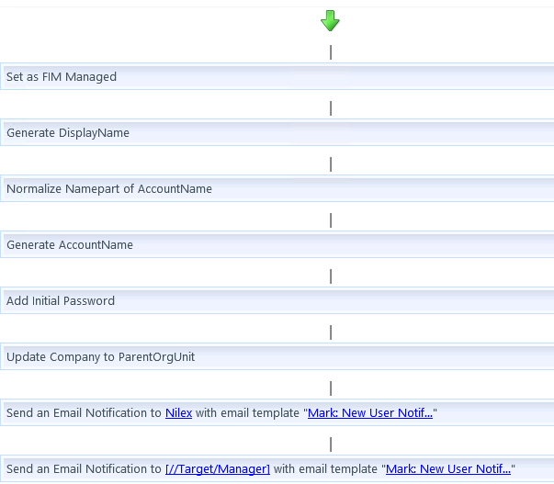
New User Example
Notes:
A typical example is when a new users is created and we have several actions needed.
Putting them in the same WorkFlow makes it easy to control the order of execution.

Slide 14
Use SQL intelligence
create view [dbo].[vOrgTree] as
/* Level describes level in org tree where 1 is the top level.
Writer: Marcus Olsson, XP Services AB, 2013
*/
with OrgTree as (
-- Anchor (get top level i tree)
select ObjectID, cast(null as varchar(50)) as Org , DisplayName, 1 as [Level]
from OrgObjekt as o
where ObjectType='O' and not exists(select * from Relations where ObjectType='O' and Kpl=2 and ObjectID=o.ObjectID)
union all
-- Underlying structure
select o.ObjectID, r.KplID, o.DisplayName, [Level] + 1
from OrgTree as ot -- This CTE (to create an iteration)
inner join Relations as r -- Relations
on ot.ObjectID=r.KplID and kpl=2 -- Find Orgs that has this as its parent
inner join OrgObjekt as o -- Info on underlying orgs
on r.ObjectID=o.ObjectID -- Connect "child" to tabel
)
select
ot.ObjectID
,'Organisation' as ObjectType
,Org
,DisplayName as Title
,[Level]
from OrgTree as ot
left join Relationer as r
on ot.ObjectID=r.KplID and r.Kpl=12
Notes:
In the previous example on using an OrgLevel attribute on OrgUnits I’m actually using a nice little SQL view to give me this as part of the data I import. Doing this climbing of the organizational tree takes only seconds in SQL even though this particular customer has about 15,000 organizational units.
There are numerous occasions where SQL or SQL Integration Services can be very useful when you need to transform data.
I used quite a lot of Integration Services a few years back but have started to move into using PowerShell combined with SQL instead. Even though PowerShell plus SQL usually is a few more lines of “code” compared to Integration Services, the requirement to use Visual Studio to edit the SSIS package made it harder for the typical IT-pro guy to understand and make changes.

Slide 15
SQL and PS MA – NOT XMA
File
Export
HR
Person
Get
Files
Org
Bulk
Insert
PS MA
FIM
SQL
Person
Org
SQL
Logic
Import
FIMObjects
FIMMVData
Notes:
The SQL view in the previous slide is used at a customer solution where the HR system exports files. A PowerShell MA picks up the files and inserts them into SQL. Within SQL I transform the file data into FIM-Optimized SQL tables.
When I tried to apply the logic by just using PowerShell I could not get the performance required to build the objects. The image you see is quite simplified, in reality the HR systems produces 5 different files with different kinds of data. One file was over 120,000 lines and contained the relations between different objects
Just as a comparison it took several hours to produce the objects with PowerShell but taking the turn through SQL we reduced the import to just a few minutes. Using a PS MA, Sörens or Microsofts, is my primary choice today when there is a need for what used to be a extensible MA. I simply never build a custom XMA within a project anymore. When migrating old solutions, that was using custom MAs, into generic PS or SSIS I have been able to reduce the amount of code by more than 90% in all cases.
I guess many of you have seen on my blog, how I have used Sörens PowerShell MA in different scenarios.

Slide 16
What about Deprovisioning?
“Kent’s Best Practices”
READ Carols great article: http://aka.ms/fimdeprovisioning
NO MV Object Deletions! Once created in MV/FIM Service it stays for traceability reasons
Repopulate join attributes using FIM Service MA or other side-meta
Deprovision using Rules Extension
Notes:
So what about deprovisioning?
Before you start discussing deprovisioning within your FIM project, make sure you read Carols article on the subject. It was written some time ago but is still very valid.
At most of my customers, deletes are forbidden! Not just in AD but in FIM itself since FIM is the source for tracing the life-cycle of the object.
Since I do not do deletes I make sure I keep the join attributes by repopulating them using the FIM Service or some SQL/AD LDS side-meta.
If you are asked to actually configure FIM to make deletes in External systems I strongly recommend using rules extension to give you the level of control you typically need when starting to automate deletes. Once again the boolean helper-flags come in handy to make the code as simple as possible.

Slide 17
Summary
“Kent’s Best Practices”
Simple logic
Synchronization Rule
Complex logic
WorkFlow activity
Performance
SQL
Notes:
To summarize my rules of thumbs… I use …
Synchronization rules for simple logic. This usually includes most provisioning scenarios.
For more complex scenarios I use the WorkFlow engine. This usually includes the need for some boolean helper flags.
Sometimes however the performance, or the crappy state of the data coming in, requires that I move some of the logic to SQL.
This was all I planned for today.
Hopefully I have showed you that even though it is in theory possible to build a FIM solution codeless, codeless should never be the goal. Instead the goal should always be less code.

