Slide 1
Advanced MIM Operations:
“Safety Catch” Design
www.unifysolutions.net
Notes:
Subtitle: Whatever you do, sh!t is going to happen, so how are you going to deal with it?

Slide 2

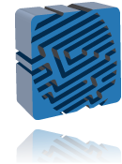
Agenda
Dealing with Mass Change
  Unexpected/expected HR events
  Unexpected AD events
  Unexpected IAM platform events
FIM threshold testing
The Windows Scheduler Solution
The FIM Event Broker Solution
Demonstration
Discussion
Notes:
Grey Slide

Slide 3
Dealing with Mass Change - HR
Harnessing HR-driven changes
  Enabling/disabling AD user accounts
  Moving user accounts to new OUs
  Adding/removing group membership
  Other (e.g. revoking O365 licenses, archiving home drives, notifications)
Unplanned activities (internal to HR)
  Bulk imports (e.g. CSV uploads)
  Bulk updates (e.g. re-classifications)
  Time-based (start/end dates)
Notes:
Just because your FIM solution does what is in its charter to do doesn’t mean that you’re going to win any moral victory when you fail to prevent a disaster.

Slide 4
HR Data Source Profiles
From API
Full imports
Polling Imports
To FIM/MIM
Full imports
Delta Imports
Notes:
Changes are surfaced differently based on nature of source data
“Foundation” (reference) data may change only daily or weekly
Other data (such as personal, job and position details) may change every few minutes
Changes made as part of “BAU” HR operations generally occur in a trickle
Changes made as a result of HR admin processes generally occur en-masse in a very short timeframe (seconds)
With a FIM/MIM connector such as the one provided by Identity Broker, these changes are combined and translated into deltas for import to FIM/MIM. This would be the same for any ECMA.

Slide 5
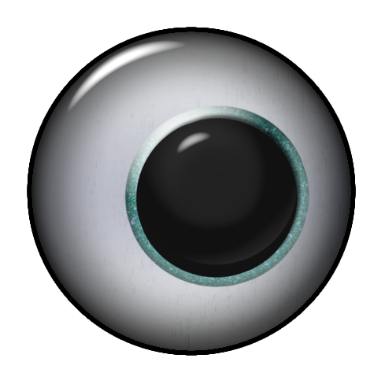
HR-driven Change
HR Data Source Sync
From HR
BAU (trickle)
Maintenance (bulk)
Desirable/Undesirable
Notes:
When bulk changes occur this can present challenges with “unwanted” or “unanticipated” change – particularly when the impact is severe and on a large user base.
Bulk changes can be accommodated in FIM by setting threshold limits (import or export) – however the built-in run profile limits are of little use because they are “after the event” and will not prevent processing of either the current “batch” or any subsequent “batches”.
Where FIM/MIM operations are scheduled, these changes are generally combined on an infrequent import basis (e.g. nightly), making bulk and BAU changes almost impossible to distinguish (even when bulk changes occur out-of-hours). With “follow the sun” FIM/MIM implementations, there is generally no (global) concept of “out-of-hours”, making it hard to separate BAU sync cycles from daily ones. Threshold limits can still be targeted, but the risk of “false positives” can be significant.
Where FIM/MIM operations are event-driven (e.g. with FIM Event Broker) bulk changes are generally more distinguishable from BAU on account of the timeliness of execution (near real time sync) – making it possible to set threshold limits more effectively. A means of prevention of concurrent sync execution is absolutely necessary.
Undesirable syncs can not always be distinguishable from desirable ones, but manual intervention can be enforced when there is any doubt.

Slide 6
Dealing with Mass Change - AD
AD Synchronisation
  Internal (e.g. Resource forest sync)
  External (e.g. DirSync/AADConnect)
  Other (e.g. O365 license management)
Unplanned activities (AD Admin)
  OU deletions/moves/renames
  Bulk user updates/deletions (UI/scripted)

Slide 7
AD Data Source Sync
From AD
Batched (scheduled MIM)
Trickle (event-driven MIM)
Desirable/Undesirable
Notes:
Again - when bulk changes occur this can present challenges with “unwanted” or “unanticipated” change – particularly when the impact is severe and on a large user base.
For enterprises where AD admin rights are effectively contained, the risk of either accidental or malicious change in the source AD can be high.
For source AD forests which are under the control of some form of automation/IAM, exposure to unwanted change can be high due to lack of awareness/coordination.
Where FIM/MIM (or AADConnect) operations are scheduled, these changes are again combined on an infrequent import basis, making bulk and BAU changes almost impossible to distinguish.
Where FIM/MIM (or AADConnect) operations are event-driven (e.g. with FIM Event Broker) bulk changes are generally more distinguishable from BAU on account of the timeliness of execution (near real time sync) – making it possible to set threshold limits more effectively. A means of prevention of concurrent sync execution is absolutely necessary.
Undesirable syncs can not always be distinguishable from desirable ones, but manual intervention can be enforced when there is any doubt.

Slide 8
Dealing with Mass Change - Platform
Synchronisation “Corruption”
  Temporary loss of connection (HR, AD, Virtual directory)
  Temp. platform loss (e.g. SQL reboot)
  Corruption of source or staged data
  Memory corruption
  IAM system reboots (e.g. Win. Updates)
  Accidental (e.g. delete connector space)
Notes:
There is always a possibility of unplanned events which can impact on any IAM server environment – with some more likely (network failure) than others (malicious interference).
Such scenarios are more likely in complex enterprise environments where multiple parties are responsible for the maintenance of various components.
Good solution design should ensure solution resilience when it comes to network connectivity failure.
Some IAM components don’t always recover from the temporary loss of SQL (e.g. FIM/MIM sync MAs can fail with a “stopped-server” status if run profiles were executing at the time, requiring either a restart of the sync service and/or a full “re-baseline” synchronisation of all MAs)
When Synchronisation activity is allowed to proceed after such an event, unexpected results are possible.

Slide 9
FIM threshold testing
Threshold limits can be set in:
  MA run profiles (generally ineffective)
  Operational scripts
Threshold limits can be tested against counters extracted from:
  WMI (where specific object classes or attributes not required)
  Audit drop files (delta import, export)
  CSExport files (full import)
Notes:
Generally built-in FIM MA run profile limits are problematic (as discussed) and therefore of little or no value.
Operational scripts are the most effective (and only) way of testing threshold limits before proceeding.
WMI calls (https://msdn.microsoft.com/en-us/library/ms697764(v=vs.85).aspx) sometimes do not give you the granularity you need. However they do provide a base set of counters to work with.
Audit drop files are best for delta imports – counts can be made of pending import adds/updates/deletes
Audit drop files are best for exports – counts can be made of pending export adds/updates/deletes
Audit drop files alone are not enough for full imports – counts are only possible of the total number of objects (all “adds”)
A file generated by CSExport.exe after the import step is best full imports – counts can be made of pending import updates/deletes.
WMI is required to check for adds for full imports (have not found a way to do this for a specific object and/or attribute set from full imports)

Slide 10
Sample FIM threshold limits
In a system with < 20K users …
Delta imports or exports
  100 adds (for user CS object class)
  100 deletes
  1000 updates
Full imports
  0 adds (e.g. no users in an LDAP MA!)
  1000 adds (across all CS object classes via WMI)
  100 deletes
  1000 updates
Notes:
When counting objects, “typed” adds are important when distinguishing between multiple object classes in the same MA.
Checking for adds can sometimes identify unwanted delete/add scenarios where the adds come through before the deletes.

Slide 11

FIM threshold triggered actions
Windows Scheduled Operations
  Halt execution
  Log/email event
  Create temporary file to halt future execution (delete when OK)
  Disable job scheduler
  Stop Scheduler service (last resort?)
From http://konab.com/scheduling-mim-advanced-options/

Slide 12
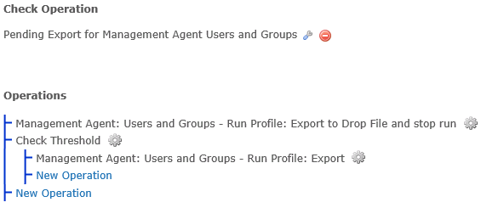
FIM threshold triggered actions
Event-driven Operations
  Halt execution
  Log/email event
  Disable Operation list(s)
  Disable scheduler
  Stop Event Broker service (last resort)

Slide 13
Demonstration
HR Event
Import Threshold Triggered
Export Threshold Triggered
HR scenarios with FIM Event Broker

Slide 14
Discussion
Questions?
Other ideas?
  What works?
  What doesn’t?

Slide 15
More information
FIM Event Broker
  http://www.mimeventbroker.com/
Advanced MIM Scheduling
  http://konab.com/scheduling-mim-advanced-options/
MIM WMI
  https://msdn.microsoft.com/en-us/library/ms697764(v=vs.85).aspx
PowerShell Advanced Functions
  https://technet.microsoft.com/en-us/magazine/hh360993.aspx

