Slide 1
System Center 2012 R2 solution overview
System Center capabilities
Infrastructure provisioning
Enterprise-class multitenant infrastructure for hybrid environments
Infrastructure monitoring
Comprehensive monitoring
of physical, virtual, and
cloud infrastructure
Automation
and self-service
Application owner agility
while IT retains control
Application performance monitoring
Deep insight into application health
IT service management
Flexible service delivery
Flexible service delivery
Notes:
Lets now jump into the meat of the discussion by introducing the key System Center capabilities.
As we go through these capability chapters, I’d like to anchor our discussions under some key areas that you (and your business) likely cares about. By the end of this presentation, I’m hoping you will see how Microsoft has a unique solution to best meet your needs for each of these areas.
Consistent with the notion of Cloud OS, “hybrid” is built into these capabilities – so you will see how System Center truly enables common management that spans Windows Server and Windows Azure environments.
Not only is System Center best-of-breed for Windows Server environments and Microsoft workloads (like Exchange, SharePoint and SQL) but it also enables robust management of heterogeneous datacenters.
System Center infrastructure management capabilities are enterprise grade and ready to use today. We’re constantly striving to reduce complexity in your datacenter by making it easy to provision, manage and operate infrastructure services based on Windows Server 2012 R2.
System Center has a relentless focus on optimizing your apps and workloads by arming you with rich insights to help you deliver predictable application SLA (after all, apps are what your business cares about and infrastructure exists to support them)
Here is a summary introduction to the capabilities:
Infrastructure provisioning – This is about enabling enterprises and service providers to provision infrastructure that meets their key requirements such as workload scale/ performance, heterogeneity, multi-tenancy and chargeback. System Center can help provision custom or standardized infrastructure for on-premises, service provider or Windows Azure environments.
Automation and self-service – System Center will continue to enable application owners the agility they need while enabling datacenter admins (in enterprises and service providers) with the tools they need to drive the needed cost-effectiveness and IT control.
Infrastructure monitoring – System Center provides a single toolset to monitor infrastructure resources - physical, virtual or cloud computing models - across on-premises, service provider and Windows Azure environments.
Application performance monitoring – Recognizing that applications are what really matter to the business, System Center provides deep insight necessary to deliver predictable application SLAs to application owners.
IT service management – System Center will continue to provide enterprise IT deliver services in a flexible manner by providing the necessary service management processes like custom service request offerings, process/ knowledge integration, and chargeback.

Slide 2







Unified management for the Cloud OS
Microsoft
App Controller
Orchestrator
(incl. SPF)
Infrastructure Provisioning
Self-service
IT Service Management
Service model
Automation
Virtual Machine Manager
Operations Manager
On-premises
Multiple tenants / customers
Windows Azure Pack
Configuration Manager
Service
admin
Data Protection Manager
Service
Manager
Service
Manager
Service
Provider
Infrastructure monitoring
Application perf. Monitoring
Notes:
Goal: Frame how System Center 2012 (and SP1) deliver unified management for the Cloud OS.
Talking Points
Let’s discuss the capabilities required to deliver on our promise of unified management:
<click> First, you need a “simple” self-service experience to enable your App Owners to specify their requirements. For example, let’s suppose they want to provision a SharePoint service with the following specs:
3 tier .NET architecture
Has a set of configuration and deployment parameters to conform with (e.g. perf thresholds, scale out rules, update domains)
Needs 99.95% availability SLA
Adheres to compliance/security controls around SOX/HIPAA
Need on-demand reporting on key availability metrics that track against SLA
<click> Next, you need a way to understand the topology and architecture of the application service in question. An application deployed in on an abstracted, or cloud computing model is called a “service”. This would necessitate a “service model” that accurately binds the application’s architecture to the underlying resources where it will be hosted. The “service model” would be comprised of:
Service definition information, deployed as “roles”. Roles are like DLLs, i.e. a collection of code with an entry point that runs in its own virtual machine
Front end: e.g. load-balanced stateless web servers
Middle worker tier: e.g. order processing, encoding
Backend storage: e.g. SQL tables or files
Service Configuration information
Update domains
Availability domains
Scale out rules
<click> You will need a set of process automation capabilities to break down this application provisioning request into the enterprise change requests that need to be implemented. This could include setting up the underlying infra and then a set of app configuration/release requests that need to be tracked (and ideally implemented with orchestrated automation)
<click> Next you need a set of provisioning tools that actually configure and deploy the infra and application layers.
<click> the underlying datacenter resources could be physical, virtual, private or public cloud as per the requirements dictated by the application’s service model
<click> once the underlying infrastructure and application service are deployed, they would immediately need to be “discovered” and monitored for reporting and health tracking
<click> There you see how the System Center 2012 components offer these life cycle management capabilities in combination to help you deliver on the Microsoft promise of unified Cloud OS management:
App Controller would offer that self-service experience that allows your application owners manage their apps across on-premises, service provider and Windows Azure environments.
Service Manager offers the standardized self-service catalog that defines “templates” for your applications and infrastructure.
App Controller, Virtual Machine Manager, Service Manager and Operations Manager work together to maintain the service model through the application service life cycle
Orchestrator and Service Manager offer orchestrated automation for the process workflows required to drive your provisioning and monitoring tools
Virtual Machine Manager and Configuration manager can provision physical, virtual and cloud environments
Operations Manager (AVIcode capabilities will be built into Operations Manager) monitors your application services end to end and offers deep app insight to help you deliver predictable SLA
Your datacenter resources could be deployed anywhere from on-premises, service provider and Windows Azure
However, to get to this agile self-service end-state, you will have to start with abstracting your infrastructure and allocating it appropriately so that your business units can deploy and manage their applications on top.
Transition: So, how does System Center 2012 get you to this point where you can deliver unified management across cloud? These can really be categorized into three buckets:
Application Management: Deploying and operating your business applications
Service Delivery & Automation: Standardizing and automating service and resource provisioning, managing change and access controls, etc.
Infrastructure management: Deploying and operating all the underlying infrastructure on which your business applications and services run.
2

Slide 3








Multi-tenant cloud infrastructure: service management automation
Enable efficient infrastructure delivery and operations
Web-based runbook authoring
Scalable, multitenant-aware automation engine built on PowerShell
Import existing PowerShell scripts and workflows
Integration with existing/ third-party systems
Web-based authoring
Workflow automation
Integration
All
ITEMS
CMDB
WEBSITE CLOUD
12
VIRTUAL MACHINE CLOUDS
12
SQL SERVER
9
Add bulk user accounts
Ticketing
MYSQL SERVERS
0
Service ticket for failed resources
Notifications
0
Notify users of plan updates
Billing
PLANS
12
Add additional SQL capacity
USER ACCOUNTS
4
Management
Systems
AUTOMATION
8
Delivered by System Center 2012 R2 through the Orchestrator component by exposing the above features as web-service APIs along with SPF integration.
Notes:
Note to presenter: As per the Cloud OS vision, our end-goal is to enable consistency between on-premises, service provider and Windows Azure. As a first step towards delivering on the vision, we’re integrating automation capabilities into the Windows Azure-consistent UX offered by the Windows Azure Pack. So, you should talk about this in the context of enabling standardized infrastructure services (for e.g. virtual machines) at service providers or on-premises environments. Target role is infrastructure admins at a service provider or mature enterprise (which has requirements around multitenant infrastructure). This is additive to the general purpose datacenter automation capabilities that System Center 2012 R2 Orchestrator provides.
This capability is surfaced through the Windows Azure Pack and enabled by tight integration between Orchestrator, VMM and Operations Manager at the back end.
Web-based runbook authoring – The Windows Azure Pack combined with System Center 2012 R2 will enable a simple web based interface where the service provider (or enterprise) infrastructure admin can consume built-in automated workflows or build their own.
Scalable, multitenant-aware automation engine built on PowerShell – System Center 2012 R2 enables a PowerShell driven automation engine that builds in tight integration between the user experience and the back end infrastructure. Windows Azure Virtual Machines (& Storage) can speak PowerShell today. PowerShell is used extensively among many enterprise and service provider organizations and we believe that this is yet another step towards standardizing how automation is done across on-premises, service provider and Windows Azure clouds.
Import existing PowerShell scripts and workflows – You can carry forward your existing PowerShell investments by importing them into the service management automation engine described above. You can also integrate System Center Orchestrator workflows with this engine.
Integration with existing/ third-party systems – It shouldn’t be a surprise that this automation engine can connect easily with existing or third party systems including billing, CMDB etc. due to it’s PowerShell based architecture and web-standard REST APIs that we are delivering.

Slide 4
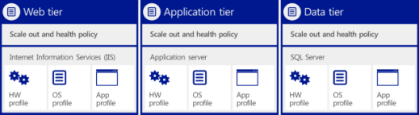







Standardized application provisioning
_{App owner}
Service template (multi-tier .NET applications)
Web tier
Application tier
Data tier
Web (IIS)
Server App-V
Data (SQL)
Scale out and health policy.
Scale out and health policy.
Scale out and health policy.
Internet Information Services (IIS)
Application Server
SQL Server
HW profile
OS profile
App profile
HW profile
OS profile
App profile
HW profile
OS
profile
App
profile
Compute
Storage
Network
DC admin
Notes:
<This capability was also delivered in System Center 2012 and SP1>
Goal of the slide
Represent how System Center 2012 R2 simplifies application provisioning for private clouds by enabling a standardized approach.
Drive CTA to identify a customer application(s) that might benefit from using capabilities like service templates
Talking points
<Click> Through service templates, System Center 2012 R2 Virtual Machine Manager offers you the ability to define standardized application blueprints, which can be used to automatically deploy application services to shared resource pools, thus simplifying application provisioning. Defining your application requirements with a repeatable construct like service templates makes provisioning faster and less error-prone.
Service templates provide the blueprint for the application service, including specifications for the hardware, operating system, and application packages. System Center 2012 R2 supports multiple package types for .NET applications, including MS Deploy for the web tier (IIS), SAV for the application tier, and SQL DAC for the data tier.
Operationalizing service templates across your service-consumer and service-provider organizations will likely require active collaboration between the App Owner and DC Admin roles to discuss and standardize the initial set of hardware, OS, and app profiles that new applications could adhere to. It might be beneficial to take an incremental approach to testing this capability before rolling out across a broader set of applications. This process will likely require broad sponsorship across the LOB application IT and infrastructure IT organizations.
<Click>
Once organizationally approved application blueprints are established and stored in the Virtual Machine Manager service template library, your application owners are ready to deploy applications on their own. They can go to the application owner self-service experience in System Center 2012 R2 App Controller, where they can access and select service templates that they’ve been authorized for. They can easily specify configuration requirements like application topology, scale-out rules, health thresholds, and upgrade rules into the service template and then kick-start a “one-click deployment.” Before the application owner hits deploy, App Controller provides a compelling visualization of the of the holistic application service, including all the requested service tiers, the underlying virtual instance templates, and storage, compute, and network resources. This enables application owners to “think services, not servers” by offering a “service-centric” approach to provisioning.
Virtual Machine Manager uses the service template specifications to build out the application tiers, including the various logical instances associated with each tier. In the real world, you are likely to encounter scaled-out (or multi-instance) web front ends and application tiers, but scaled-up (or single instance–based) database tiers.
Virtual Machine Manager uses the service template specifications to ensure that the application is deployed to the appropriate virtualized resource pools.

Slide 5
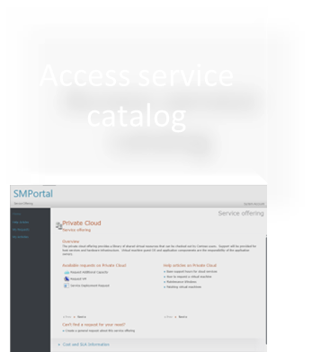
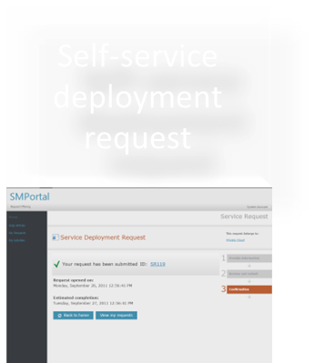
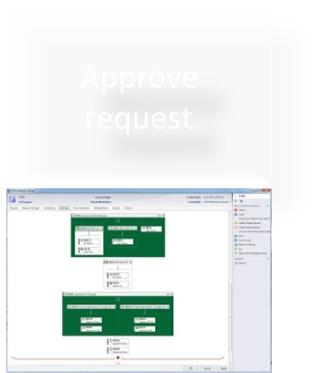
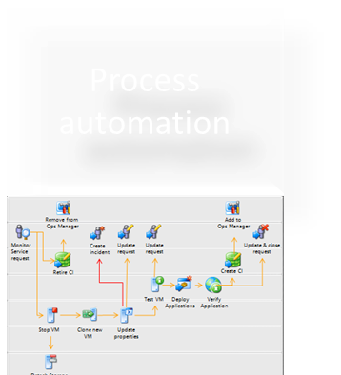
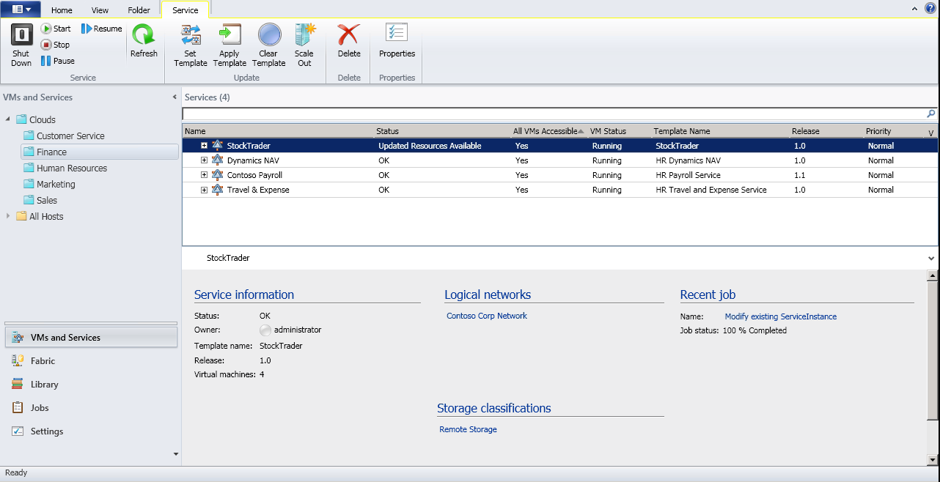
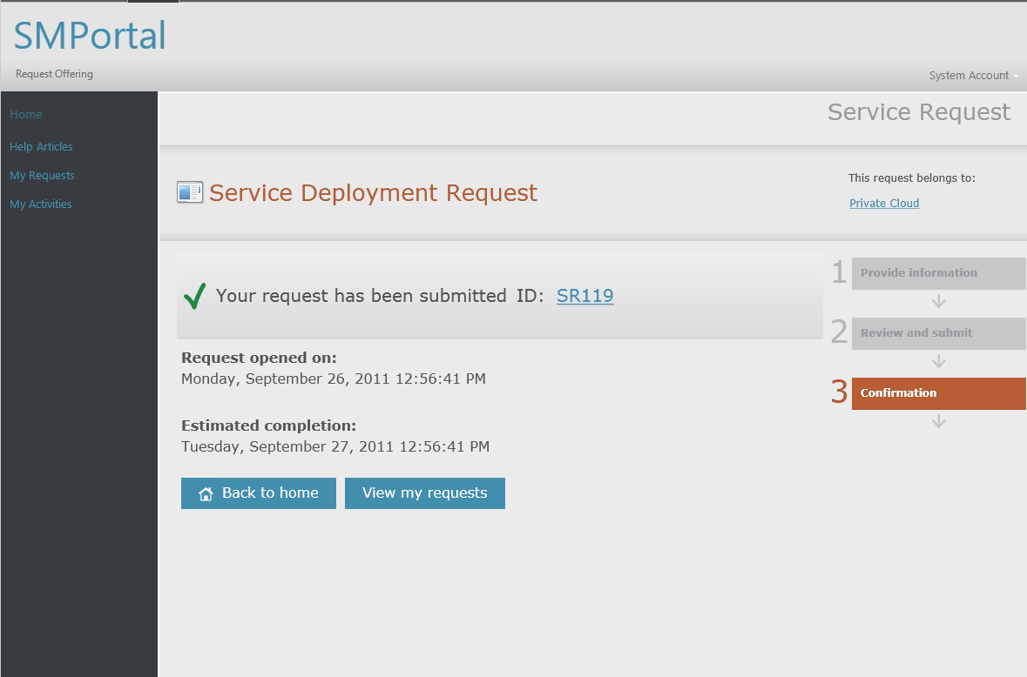
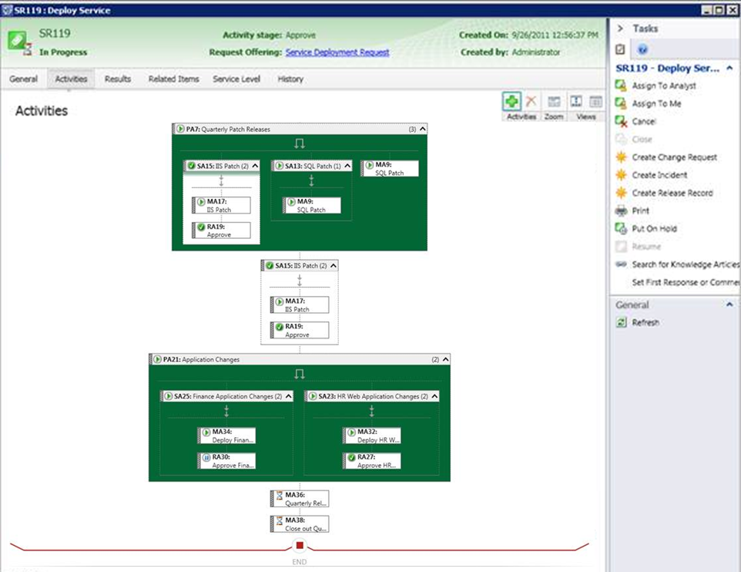
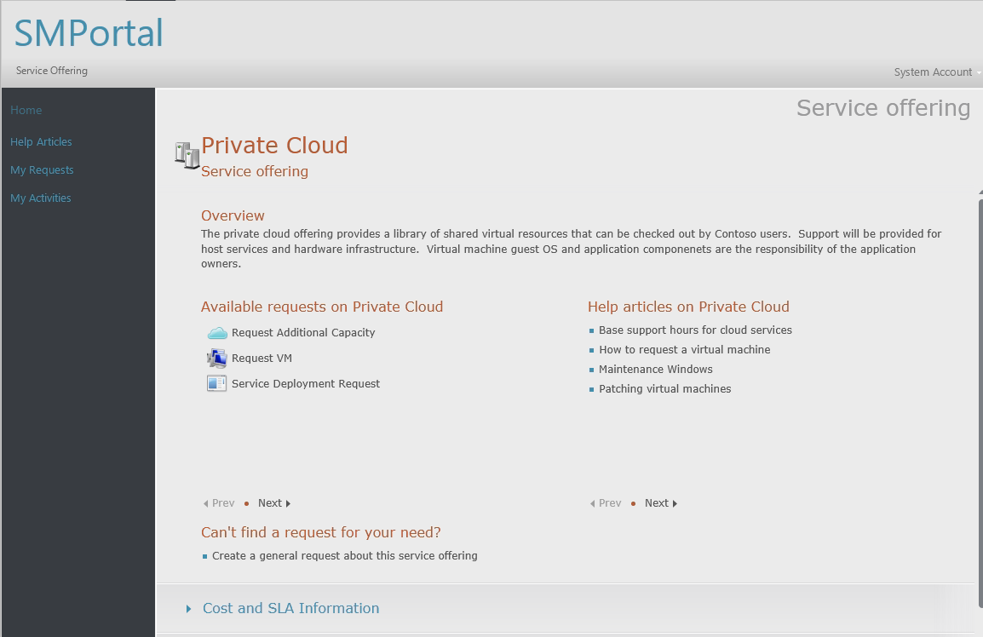
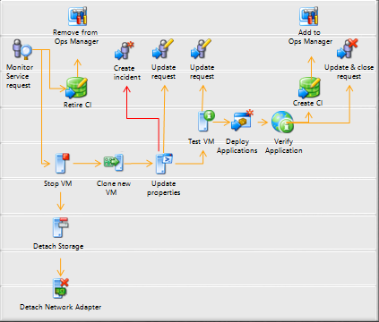
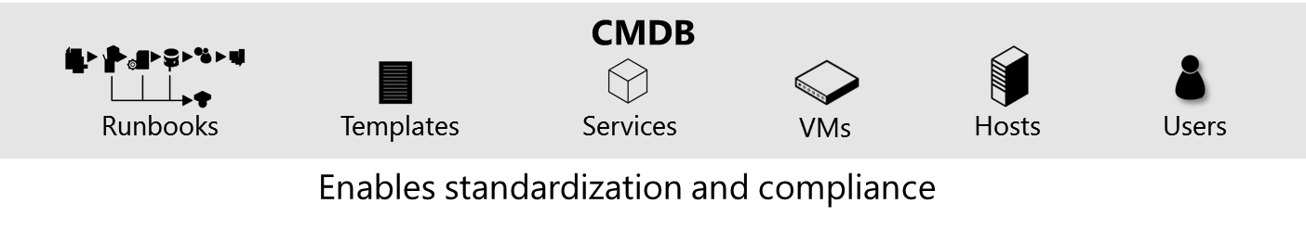



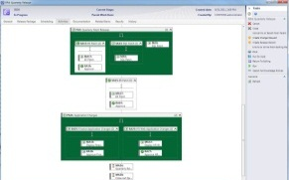

Flexible service delivery
Approve request
Provision service
Self-service deployment request
Access service catalog
Process automation
Access service catalog
Self-service deployment request
Approve request
Process automation
Provision service
Notes:
Goal of the slide
Showcase how System Center 2012 R2 enables predictable service delivery.
Talking points
Do you know that a majority of application or infrastructure outages can be traced back to poorly defined and executed change management?
What we’ll talk through now is an end-to-end scenario that enables you to deliver predictable datacenter services on-demand to your application owners (or end users). This scenario takes off at the point where IT publishes a list of standardized service offerings that can be consumed in a self-service mode.
It walks you through the process by which System Center 2012 R2 fulfills a service deployment request in a controlled manner. The service in question could be an application service or an infrastructure service.
<click> The Configuration Management Database (CMDB) in System Center 2012 R2 - Service Manager standardizes the capture of relationships across infrastructure and applications, thereby facilitating continued organizational compliance through any changes to these. If you are managing a private cloud, the CMDB can track various configuration items such as virtual machine templates, application service templates, virtual machines, hosts, and application services. The CMDB acts as the integration point across people, processes, and knowledge through this process.
<click> The application owner or end user accesses the published service catalog and requests deployment of a pre-defined service offering.
<click> The application owner requests the service offering in self-service mode, resulting in the creation of a service request. Additionally, the corresponding business process required to fulfill this request is triggered.
<click> Now, it turns out that this service deployment request is a “complex” request that impacts changes to multiple application and infrastructure configuration items. So Service Manager triggers change/release management approvals with the corresponding functional approvers before kicking off actual deployment. You can use the example of a real-life service request that impacts business mission-critical systems, and hence needs these approvals.
<click> Once all the required functional approvals are obtained, System Center 2012 R2 – Orchestrator triggers automated execution of a preconfigured runbook for this service deployment request.
<click> System Center 2012 R2 – Virtual Machine Manager provisions the service (including all the underlying configuration items like hosts and virtual machines) following the specifications in the service request. All these activities are tracked back to the service request in the form of an audit trail to ensure the right level of control at each step.

