Slide 1


FIM MOBILE PRESENTATION
Rob Allen
rallen@activeidm.com

Slide 2


What to Expect?
FIM MOBILE
Solution Overview
Quick introduction of the technology and the use cases
Explanation of FIM Web Services integration cross-platform
Review of Platform specific integration
Demonstration of WP and iOS
Q&A

Slide 3



FIM MOBILE – HIGH LEVEL DESIGN

Slide 4

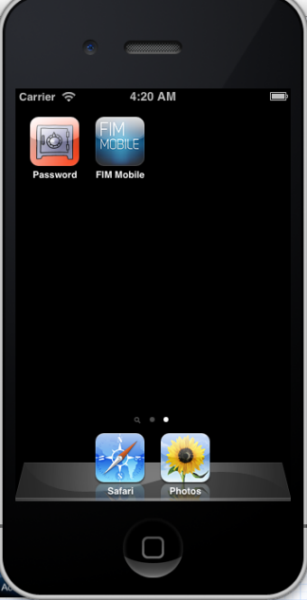
Environments
FIM MOBILE – ENVIRONMENT INFORMATION
Windows Phone
  Visual Studio 2010/2012
  Windows Phone SDK
  Windows 7/8
iPhone
  Xcode 4.x, 5.x
  iOS SDK
  Mac OS

Slide 5
FIM MOBILE
Solution Overview
Mobile technology tools from Microsoft and Apple leveraged for integration with FIM
One WCF Service Application built and enhanced to handle FIM Web Service calls
Xpath filters for getting Resource information from the FIM Web Service
Note: The WCF is platform independent – works for WP, iOS, and Android!

Slide 6
FIM MOBILE
Solution Overview
Creation of strongly-typed resources for use in Transaction updates in the FIM Web Service
Search Approvals, Approve and Reject Approval Requests
Search Users and review group access

Slide 7
Solution Usage
FIM MOBILE
Approval Requests delivered to the mobile device (on-the-go)
Search users and review meta data
-Join/Leave Groups
Search Groups
Self Service Password Reset on mobile devices
Customized Settings for client distribution

Slide 8
FIM MOBILE
Use Case Scenario
#1 → Approval requests are queued to a manager and viewed on the Mobile Device
#2 → Manager approves/rejects the requests
#3 → System Administrator needs to review user data
#4 → Password Reset from the Mobile Device
#5 → Ability to configure different endpoints

Slide 9

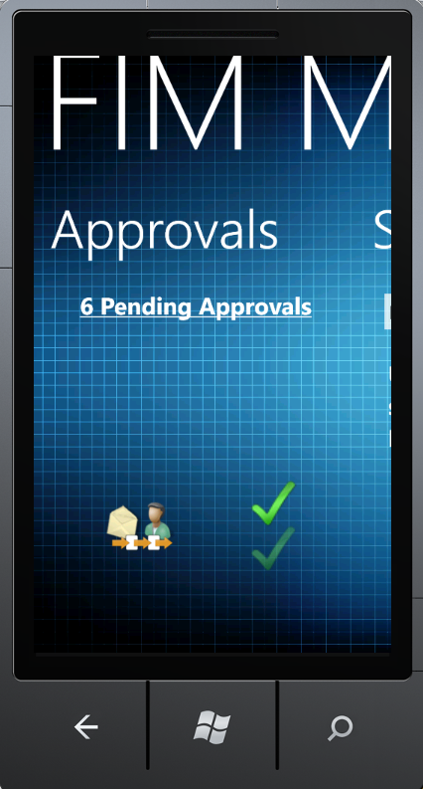
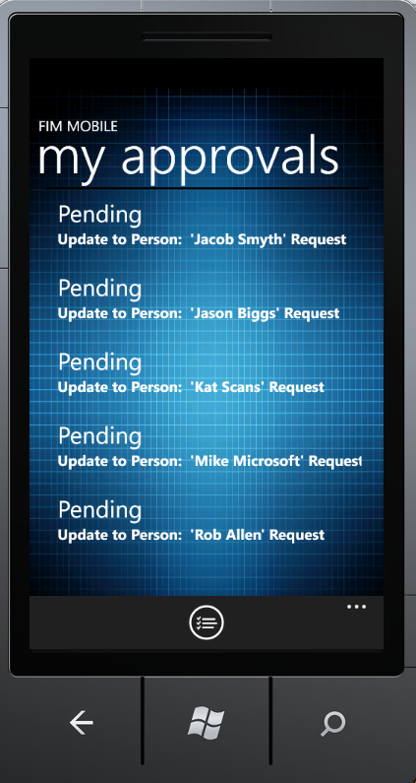
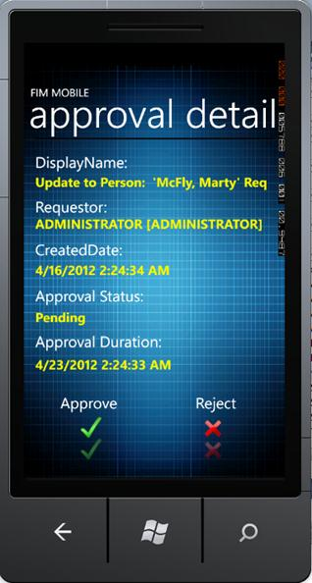
Approvals Windows Phone
FIM MOBILE

Slide 10

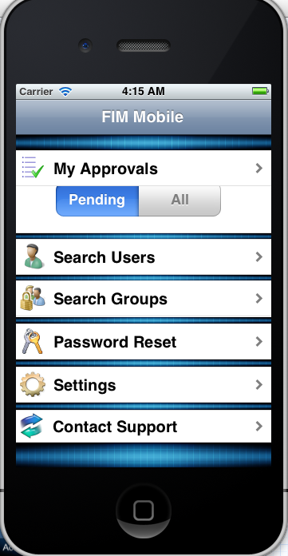
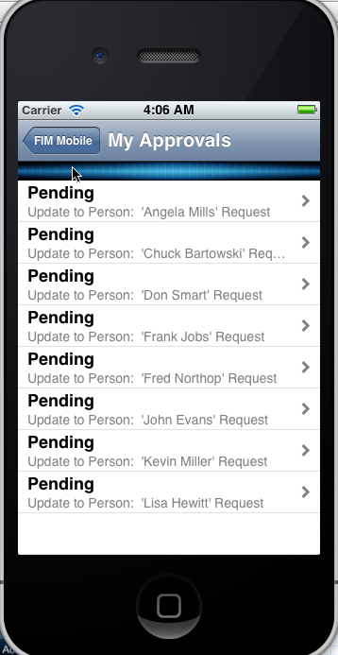
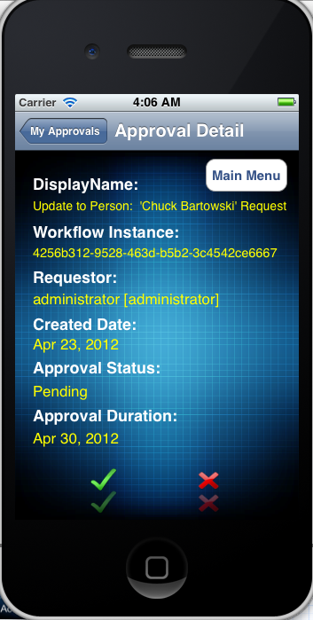
Approvals iPhone
FIM MOBILE

Slide 11
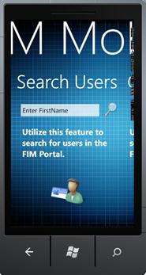
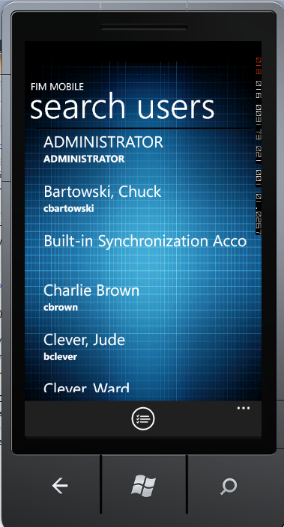
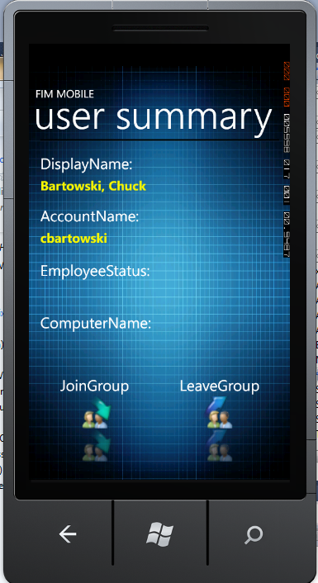
Search Users Windows Phone
FIM MOBILE

Slide 12
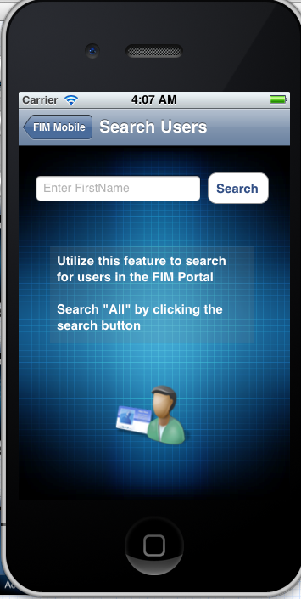
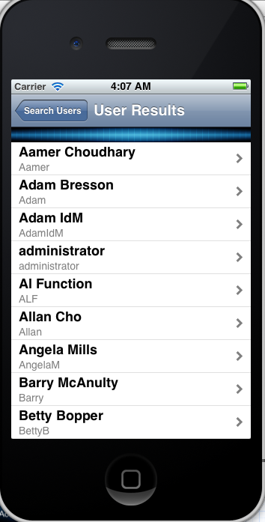
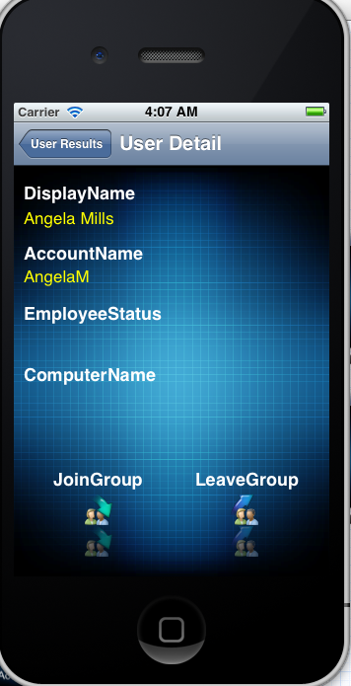
Search Users iPhone
FIM MOBILE

Slide 13
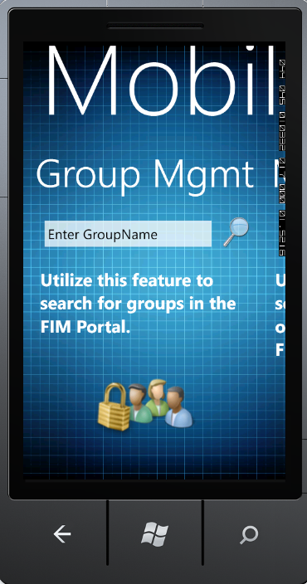
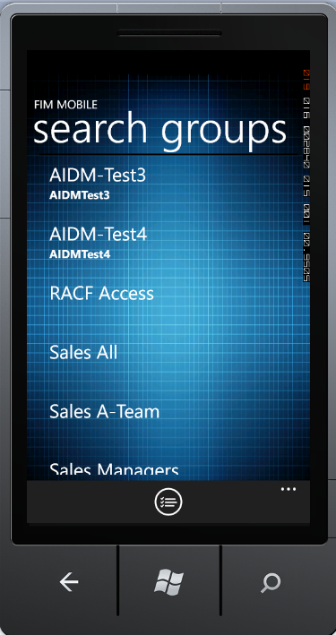
Search Groups Windows Phone
FIM MOBILE

Slide 14
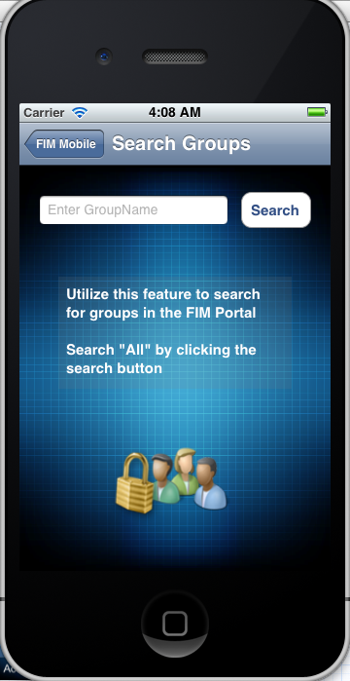
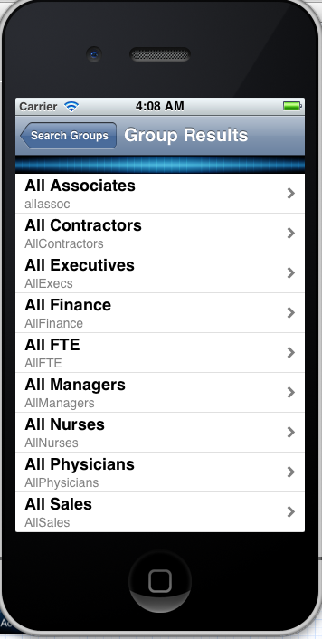
Search Groups iPhone
FIM MOBILE

Slide 15
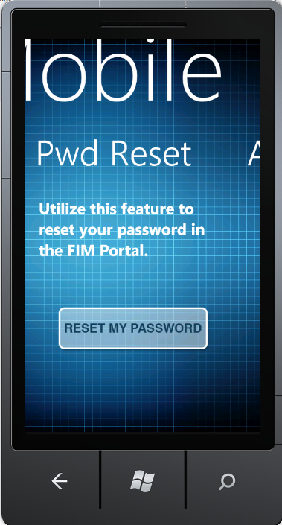
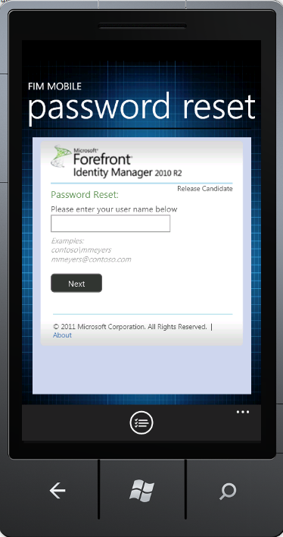
Password Reset Windows Phone
FIM MOBILE

Slide 16
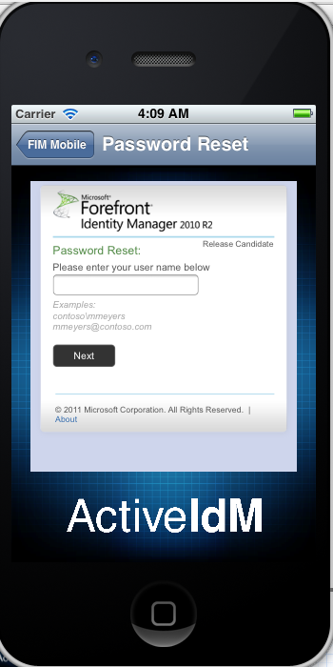
Password Reset iPhone
FIM MOBILE

Slide 17
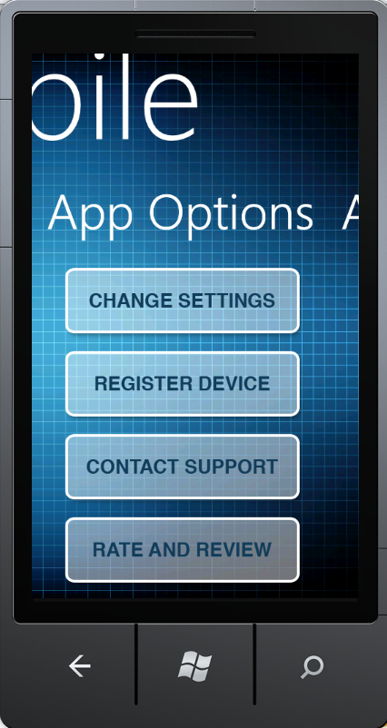
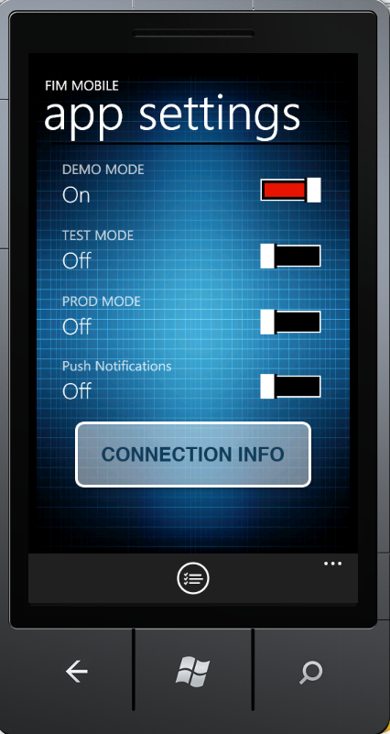
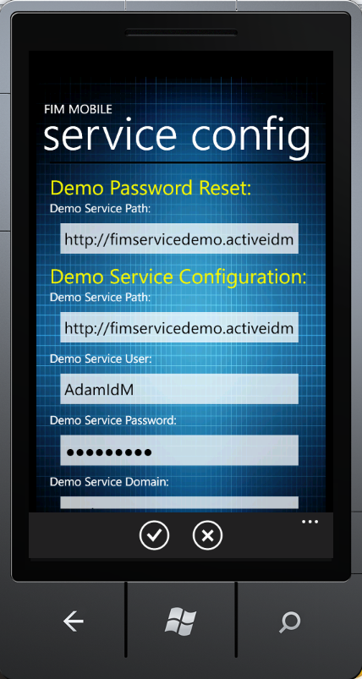
Dynamic Settings Windows Phone
FIM MOBILE

Slide 18
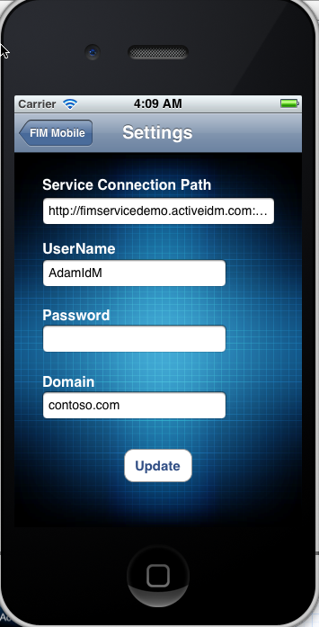
Dynamic Settings iPhone
FIM MOBILE

Slide 19
Demonstration of WP
FIM MOBILE
Review Visual Studio
Emulator
Quick Code Review
Live Demo

Slide 20
Demonstration of iOS
FIM MOBILE
Review Xcode
Emulator
Quick Code Review
Live Demo

Slide 21




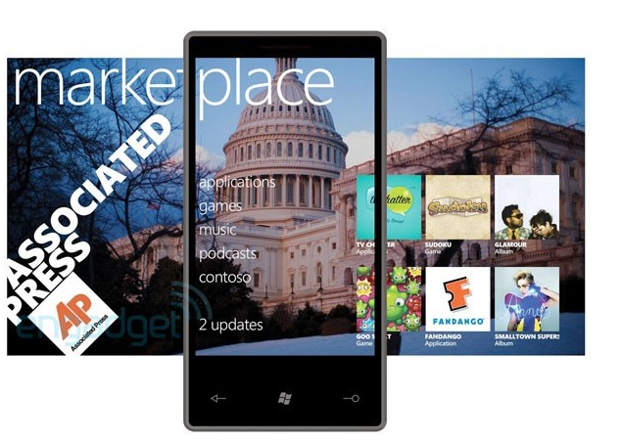

Marketplace or AppStore
You choose....

Slide 22
Q&A?

Slide 23
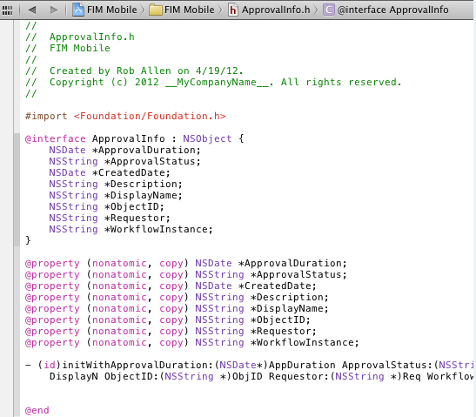
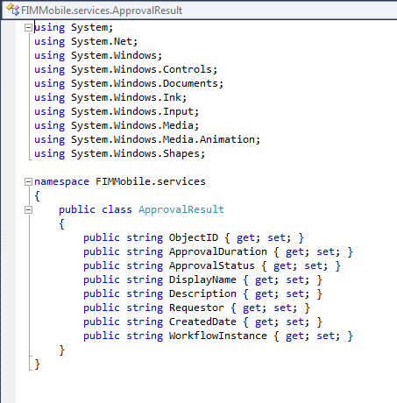
Objective C vs C#
Class objects

Slide 24
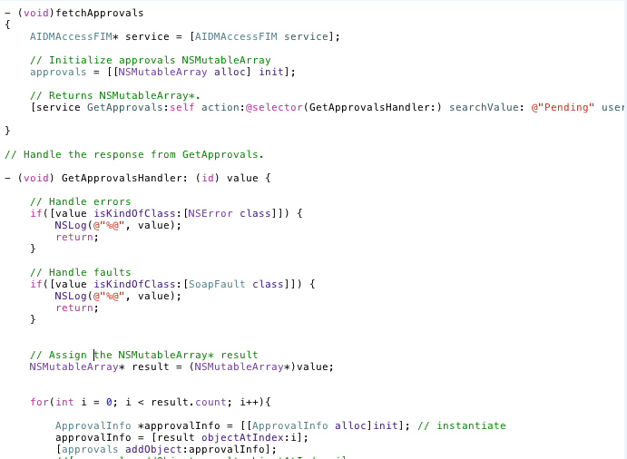
Objective C vs C#
WCF Calls in Objective C

Slide 25
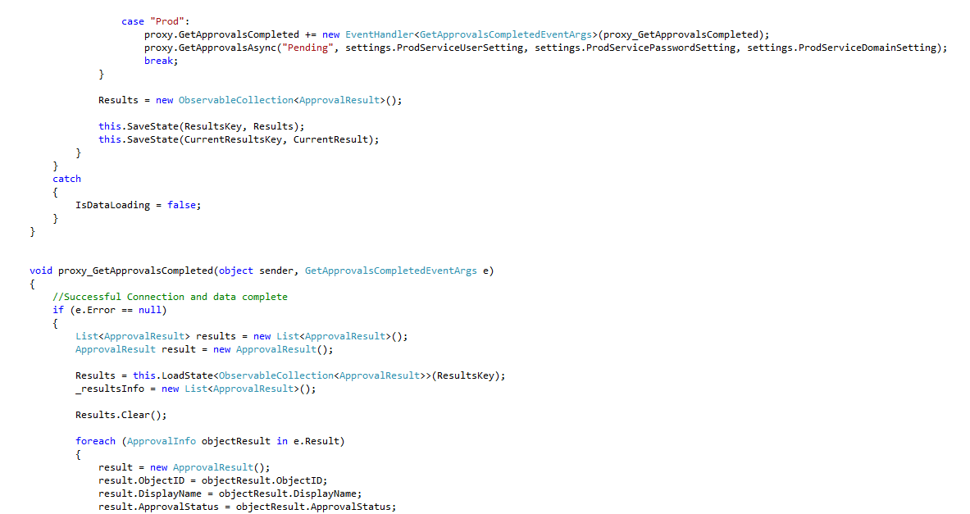
Objective C vs C#
WCF Calls in C#

Slide 26
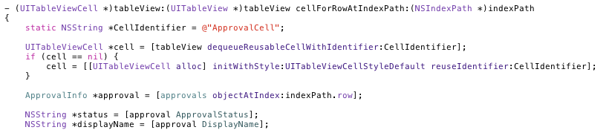
Objective C vs C#
List View and Tables in Objective C

Slide 27
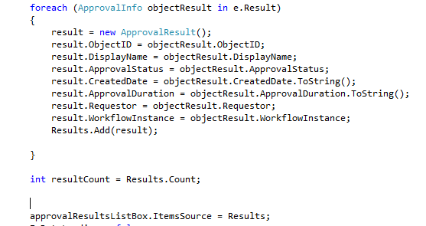
Objective C vs C#
List View and Tables in C#

Slide 28
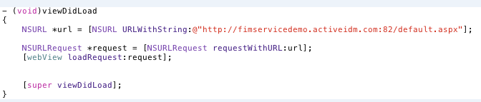

Objective C vs C#
Web UI Control
Objective C
C#

Slide 29
Visual Studio and XCode
Visual Studio produces XAML and XAML.CS as part of the page creation
XCode you have to separately create the class objects and assign (drag/drop) the class object outlets
Visual Studio allows for .Net intellisense
XCode Storyboard is available versus page-by-page navigation/setup

Slide 30
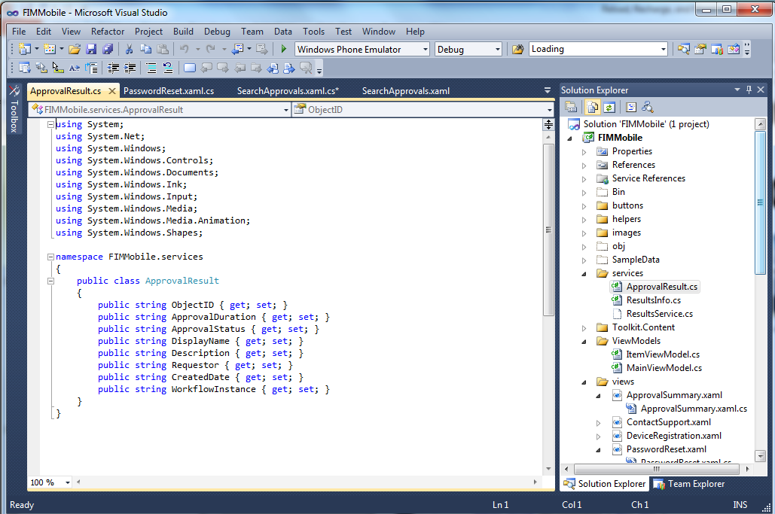
Visual Studio and XCode

Slide 31
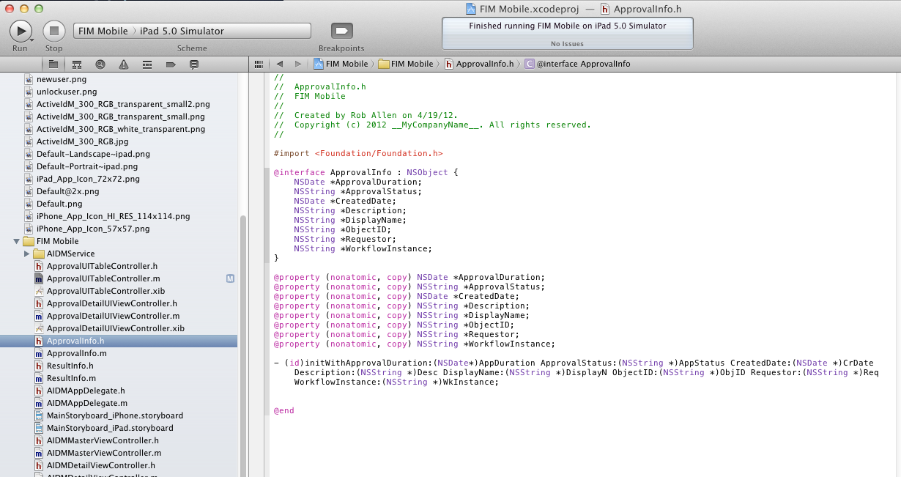
Visual Studio and XCode

Slide 32

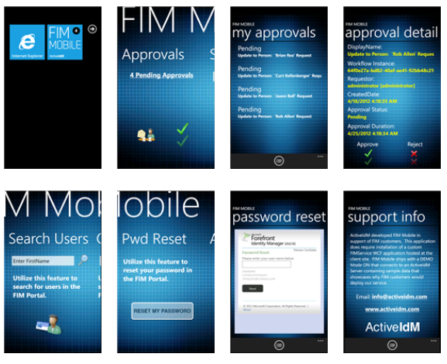
FIM MOBILE (con’t)
For inquiries and pricing information email info@ActiveIdM.com
For more detailed information about FIM Mobile visit www.ActiveIdM.com

Slide 33
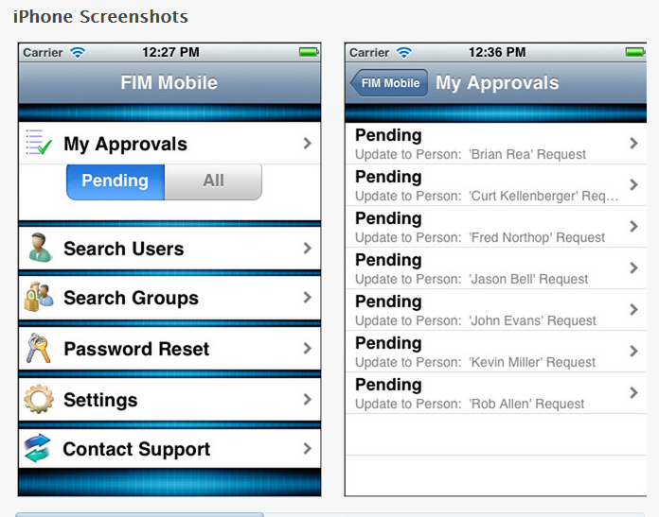
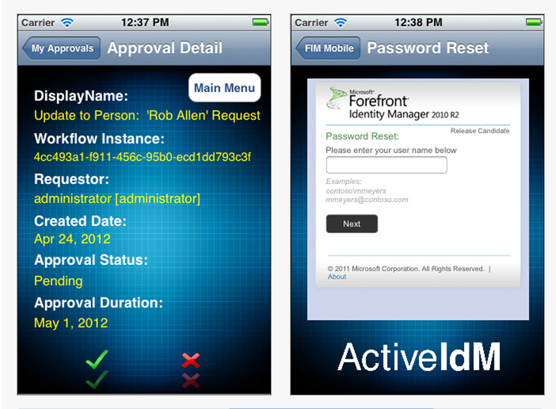
FIM MOBILE (con’t)
Capture the power of mobile devices allowing users the flexibility of performing tasks that up until now, could only be done from workstations in the corporate network environment. Reduce costs, latency, and increase productivity with FIM Mobile.
For inquiries and pricing information email info@ActiveIdM.com
For more detailed information about FIM Mobile visit www.ActiveIdM.com

