Slide 1

How does IDM impact the Bottom Line?
How to sell Identity Management
David Lundell, Identity Managed LLC
Principal Consultant, MVP, MBA, Author
Twitter: DavidLundell

Slide 2




Benefits of Identity Management
IT & ComplianceCosts
IT & ComplianceCosts
Twitter: DavidLundell

Slide 3
Obstacles to selling IDM
Limited budgets and manpower
Existing IT Architecture
Really uncooperative Applications
Limited time with executive leadership
Hard for people to see the connection to the big picture and Impact on Bottom line?
Tech people can drone on and on and have very boring texty slides

Slide 4
3 keys
Align to the CEO’s goals
Align to CFO’s goals
Show potential bottom line Impact
Be concise
Don’t waste their time
Win allies
Twitter: DavidLundell
Notes:
Key to winning is to show the business leaders how your goals of IDM will help implement their goals, scratch that are critical to their goals. That means aligning with strategic objectives, showing how it can impact the bottom line and being concise.
In 2012 at the Gartner Identity Summit Lori Rowland advised to sell IDM as a program and not a project, to constantly sell it and show success. Cautioned against ROI and to go for qualitative rather than quantitative. I agree that we should emphasize the qualitate and then the financials become the icing on the cake. I don’t think the financials should be ignored.

Slide 5
Align your goals
Discover organizations strategic goals
Tie Identity Management goals to them
Twitter: DavidLundell

Slide 6
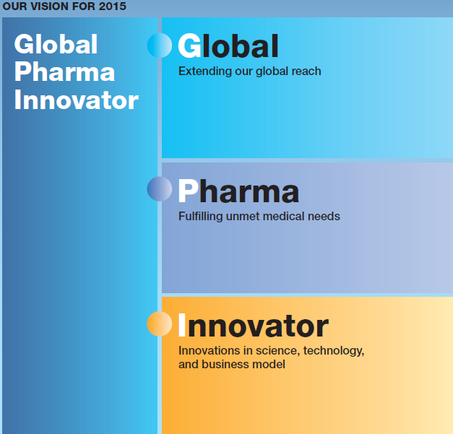

Possible Goals for a Pharma
Up to date contact info across all 100+ subsidiaries and affiliates
Provide/gain access to other subsidiaries organizations’ resources
Secure collaboration with Partners (like SoAndSoGenetics, Eli Lilly)
Automatically update Distribution Groups (the Pharma RAD teams)
Streamline Business support
  IT empowering employees from Day 1
  Protect IP from moment of employee departure
Playbook for M&A IT (focus on Identity Management)
Notes:
Back in 2010 I visited a Pharmaceutical and presented the following.
<Click>
On the left is a great graphic I snagged from their annual report. I used their graphic to come up with IM goals for each category.
<CLICK>
Once I completed the presentation,
<CLICK>
the IT executive’s jaw dropped and said “this is almost exactly what I told Tokyo we needed to do.”
<Click>
They ended up signing a deal for Identity Management which was a great win for us.

Slide 7
Show potential bottom line impact
Depending on type of project it will have a different impact
Twitter: DavidLundell

Slide 8

Be Concise
Say it in Six Minutes By Ron Hoff
Don’t forget to have a specific ask
Twitter: DavidLundell

Slide 9

Benefits
Twitter: DavidLundell
Notes:
Gain allies and steamroll blockers
Programs that know how they benefit the bottom line are always a plus
Conciseness stands out vs. droning on
Easier to get a 15 min meeting with upper management than an hr

Slide 10
Ready to dig into how or any questions first?
How to Align to the CEO’s goals
How to Align to CFO’s goals
Impact on Bottom Line
How to Be concise
Twitter: DavidLundell

Slide 11
How to Align to the CEO’s Goals
Twitter: DavidLundell

Slide 12
Aligning Sales Pitch with Client Goals
Annual Report
Press Releases
Social Media
Employment Ads
1. Research Organization’s Goals
2. Extract top 4-6 org objectives and trends
3. List how Identity Management can aid in those goals
4. Present to Leadership and learn more
Mergers & Acquisitions
Partnerships
Growth
New LOB
Reduce costs
Notes:
Selling Identity Management is best done by helping your client contact see how Identity Management can make him/her look good. If you can show them how Identity Management supports the organizations goals, not IT’s goals, but those of the organization, you have just made it so much easier for your contact to sell this internally. This requires some thought and work
<Click>
Start by Researching the Organization’s Goals
<Click>
Read Annual Report – they often state their major goals right here. Also look for info on Mergers & Acquisition (M&A) activity
Before I visited a medical device company I read their annual report and was able to describe what was happening in their company, as in I bet the business is opening up new lines of business and they are signing up for cloud apps before you can talk to them. Then when I told them about the new line of business they were set to open next quarter, they were surprised – they didn’t know. As you can imagine they were impressed with how I was trying to help their business.
<Click>
Press Releases – the press releases can show a history of M&A activity and also provide updates that alter what you read in the Annual report
<Click>
Social media – Listen to what others are saying about your client
<Click>
Employment Ads – learn about what systems they have and hints of new efforts
Look at stock price over trailing twelve months for a quick read of how they are feeling as a business
<Click>
2. Next, Extract the top 4-6 org objectives and trends
<Click>
Look at Mergers & Acquisitions
<Click>
Partnerships
<Click>
Growth
<Click>
Adding new lines of business
<Click>
Pressure to reduce costs
<Click>
3. Then, List how Identity Management can aid in those goals
on the next two slides you will see some examples.
<Click>
4. Present to the client and learn more
<Click>
Sometimes you get it just right other times this merely opens the door for deeper discussions

Slide 13

Possible Identity Management Goals
Continue to Leverage our Strong Brand and Market Leadership Position
Focus on Value-Added Products (packaged salad lines and Fruits and other non-canned products)
Focus on Improving Operating Efficiency and Cash Flow
Pursue Disciplined Growth
Promote Education through the Nutrition Institute
Encourage Corporate Social Responsibility
Continue to Leverage our Strong Brand and Market Leadership Position
Focus on Value-Added Products (packaged salad lines and FRUIT BOWL and other non-canned products)
Focus on Improving Operating Efficiency and Cash Flow
Pursue Disciplined Growth
Promote Education through Dole Nutrition Institute
Encourage Corporate Social Responsibility
Consolidate AD Forests
Automate user deprovisioning
Enable growth by automating user provisioning and group management
Use Federation to efficiently share access to resources between the Institute and their research partners
Use Group Management to support the creation of teams to focus on new product lines
Share appropriate info with Unions, and community organizations through Federation
GalSync – increase comm. Among BU’s
Consolidate AD forests
Deal with Separation at AD level
Twitter: DavidLundell
Notes:
By doing the research on the previous slide I identified
<CLICK>
six major goals for a Produce company as seen on the left and then
<CLICK>
I put on my thinking cap and came up the ways that our Identity Management services could help their IT contribute towards these goals
<CLICK>
as shown on the right.
Now we are engaging for an AD review preparatory to a consolidation as well as they are interested in SSO and Identity management

Slide 14
Demo
Pick a publicly traded company – and let’s look at their annual report
Twitter: DavidLundell

Slide 15
How to show bottom line impact (aligning with CFO)
“Identity Management is the only compliance effort that pays you back” – Client
Twitter: DavidLundell

Slide 16
Income Statement Primer – Microsoft 2014 Annual Report (billions)
Twitter: DavidLundell
Notes:
MSFT 2014 revenue $86.8 B – where does it go? COGS (Cost of Goods Sold) for a product company, Cost of Services for a services company or as MSFT puts it Cost of Revenue.

Slide 17
Technology Impacts on Bottom Line
Revenue
CRM
COGS
SPC
R&D
SG&A
Taxes
Interest
ERP
3D Printer
CAD
SCM
ERP
IT Automation
HR
ERP
SCM
HR
CRM
Accounting
Twitter: DavidLundell

Slide 18


User Provisioning/Deprovisioning
Automate repetitive tasks
  Lower IT costs (SG&A)
  Enables Revenue to grow faster than IT costs
    Leverage
Get new employees access faster
Notes:
Automating provisioning and deprovisioning can lower Sales General and Administrative Expenses
Enables Revenue to grow faster than IT costs
Leverage

Slide 19
Self Service Password Reset
Return workers to productivity
  Increase revenue
Reduce help desk calls
  Lower IT cost as a % of Revenue
Enables Revenue to grow faster than IT costs
Notes:
Self-Service Password Reset is both the

Slide 20
Role Based Access Control
Protect Revenue
User productivity can be improved
  Or be neutral
Lower SG&A
  Lower Audit cost

Slide 21
Single Sign On
Return workers to productivity
  Increase revenue
Reduce help desk calls
  Lower IT cost as a % of Revenue
Enables Revenue to grow faster than IT costs

Slide 22
Federation with Partners
Increase Revenue
Lower SG&A

Slide 23
Multi-Factor Authentication
Protect Revenue
Lower User productivity slightly and hence revenue
Slight Increase SG&A
Notes:
Unlike many of the other Identity Management areas there is no corresponding automation that lowers costs. Instead it increases them slightly but is a growing must in order to protect revenue – just ask Sony. Years ago MSFT implemented Smart Cards – rumor has it that it was to eliminate certain operatives from a powerful Asian nation from gaining access to their source code. MFA won’t eliminate hacks but it makes it harder for many of them to take place

Slide 24
Gal Sync
Increase Revenue
Lower SG&A
Notes:
Right after a merger or between subsidiaries Galsync can provide a huge boost to user productivity and hence revene

Slide 25
Calculating Bottom Line impacts
Hard costs
Leverage
Show how Revenue can grow with IT costs growing at a slower pace
Savings
Lower IT costs
Labor
Vendor
Soft Costs
User Productivity
Protection
Twitter: DavidLundell

Slide 26
How to Be Concise? How to get your ideas the attention they deserve?
Twitter: DavidLundell

Slide 27
Questionable Persuasion techniques
Gifts
Hard sell
Rolling fountain pen trick
Used Car Salesman
Talk them to death
Extortion
Twitter: DavidLundell

Slide 28
Limit your presentation to six or seven minutes
Jump right into the burning question: 30 seconds
Background: 90-120 seconds
IT (Idea in Tangible form): 120 seconds
Benefits: 120 seconds
Interactive Close: 30 seconds
Twitter: DavidLundell

Slide 29
Say it in Six: How to Say Exactly What You Mean in Six Minutes or Less by Ron Hoff
Twitter: DavidLundell

Slide 30
Benefits of Conciseness
Executives love directness
Executives love not wasting time
Easier to get a 15 min meeting
Easier to get a follow on meeting
Stand out from the crowd

Slide 31
Interactive Close
Monday
Buy and read Say it in Six by Ron Hoff
Read http://www.investopedia.com/articles/basics/06/financialreporting.asp
Next week
Three weeks
Create and practice presentation
Make appointment
Download the annual report and extract top objectives
Pick Identity Management programs to pitch
Align goals with the objectives
Two weeks
Learn more about top objectives and active programs –listen – ask questions
Notes:
What are our follow up steps

Slide 32
Thanks
www.IdentityManaged.com
Twitter: DavidLundell

