Slide 1
Privileged Access Management (PAM) with MIM 2016
Peter Stapf
MVP – IAM @ Enterprise Mobility
18. November 2015

Slide 2
About me
Age: 44
Location: Germany, Bonn
MVP (IAM @ Enterprise Mobility)
Senior Consultant @
Main focus: IDM, AD, Azure
Working on IDM since 2006
Blog: http://justIDM.wordpress.com

Slide 3
Agenda
Introduction
Components & Architecture
Implementation
Differences between WS 2012 R2 and WS 2016
Good/Best Practices
Limitations & Issues
Demo

Slide 4
Introduction
An attack timeline
You can use Advanced Threat Analytics (ATA) for discovery of attacks in your environment

Slide 5
Introduction
What is Privileged Access Management (PAM) for Active Directory ?
Implementation of Just-In-Time Administration with MIM 2016
Lifecycle Management of privileged group memberships
Separate/different deployment scenario
Benefits of PAM ?
Separate admin accounts from user account with a new stronger forest
Mitigate pass the hash attacks
Permissions (Group membership's) applied only if needed
Add additional authorization (Time Limits, Approvals, Azure MFA)
Add reporting, auditing and monitoring of high privileged groups
Consolidate multiple admin accounts

Slide 6
Components & Architecture
Corp Forest
Priv Forest
WS2003+
Trust (One-way) Corp forest trusts priv forest
WS 2012 R2 (WS 2016)
MIM 2016
PAM Component
PAM Monitor
MIM Service
(MIM Portal)
Additional Corp forests…

Slide 7
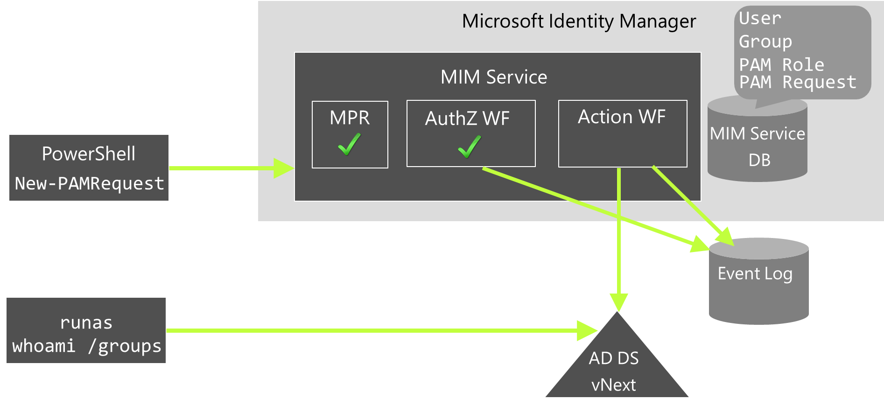
Components & Architecture

Slide 8
Implementation
Corp Forest
Priv Forest
Trust (One-way)
Corp forest trusts priv forest
New-PAMGroup
ObjectSID -> SidHistory
New-PAMRole
FileAdmins
CORP.FileAdmins
New-PAMGroup
ObjectSID -> SidHistory
CORPAdmins
SQLAdmins
CORP.SQLAdmins
New-PAMUser
Candidate
Peter
Priv.Peter

Slide 9
Implementation
Requesting Role by PowerShell
Requesting Role by REST-API (Sample Portal)

Slide 10
Differences WS 2012 R2 vs. WS 2016
New AD Object Type: msDS-ShadowPrincipal instead of groups
Member will be removed by AD not by PAM on expiration
Simplified deployment (ex. no audit policys needs to be enabled)
Well known SID groups (Domain Admins) can become a PAM group
Kerberos Token TTL will be the smallest TTL of a PAM group
Use of msDS-ShadowPrincipalSid instead of sidHistory attribute

Slide 11
Good/Best Practices
First: Always use PowerShell for PAM administration !!!
Do not install SharePoint Foundation and MIM Portal
Do a PAM forest hardening after deployment (ex. GPOs, Firewall)
Limit admins that can access the PAM forest
Apply additional authentication to PAM admins (ex. SmartCard)
Implement MFA / Approvals for PAM requests if possible

Slide 12
Limitations & Issues
Azure MFA currently supports phone calls only
Well known groups SIDs cannot be migrated to PAM groups (Workaround: nest PAM group into Built-in\administrators on DC)
PAM Role approvers are always candidates
Bug: MIM Monitor tries to connect to CORP domain by NetBIOS Name (Workaround: create hosts file entry with domain name)
Missing PowerShell parameters (ex. add/remove single candidates)
Availability Windows only on hours not days of week

Slide 13
Demo

Slide 14
Links
MIM PAM Deployment Guide https://technet.microsoft.com/en-us/library/mt345568.aspx
Using Azure MFA for PAM https://technet.microsoft.com/en-us/library/mt517876.aspx
Eihab’s great small video on the PAM user experience https://www.youtube.com/watch?v=Iqif5vRg2GY
My blog posts about PAM https://justidm.wordpress.com/tag/pam/

