Slide 1

Predica bag of (FIM)tricks
Tomasz Onyszko (tomasz.onyszko@predica.pl)

Slide 2

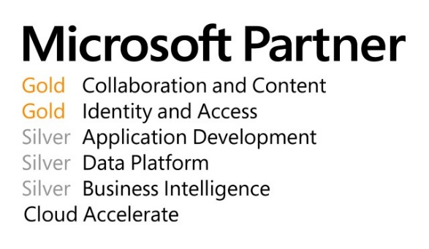
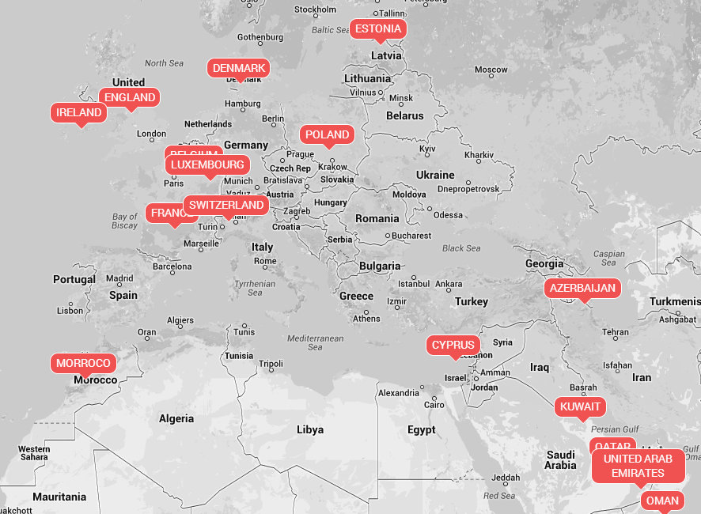
Word from our my sponsor
Based in Poland … present world wide
We do work with IAM – not only FIM .. .
  … but lots of FIM ☺
30+ consultants

Slide 3
Word from our my sponsor
Blog: http://blog.predica.pl
Web: http://www.predica.pl

Slide 4
Agenda
FIM UI extensions – publishing the other way
Office 365 management with PowerShell and Soren’s help
AutoGroup on FIM: idea and implementation

Slide 5
FIM UI way, or highway … really??

Slide 6
Our story with FIM UI extension
We all know FIM UI story so let’s skip it
First attempt:
  Major makeover of FIM UI portal
  Completely replacement for “user” part of portal with many custom object types and scenarios
Project
  300 application screens developed
  Team of 10-12 people, 80% of pure app developers
Result
  FIM Client Library - https://github.com/Predica/FimClient

Slide 7
Conclusions #1 – Deployment
How to build and deploy FIM UI solution??
  On SharePoint
  Avoid manual changes to FIM resources
  Do not be affected with FIM upgrades
Solution - SharePoint feature (web part)
  Easy to deploy – feature on the site
  Easy to configure
Result
  Integrate literally any page with FIM portal layout

Slide 8
Short Demo Time #1
FIM UI integration

Slide 9
Conclusions #2 – Infrastructure
Make sure that your infrastructure is right
  SharePoint configuration
    Alternate access mappings
    Kerberos configuration
  Network load balancing – software or hardware
    Session problems

Slide 10
Conclusions #3 – Development
First attempt
  We’ve built set of ASP .NET controls for FIM resources
    Flexible
    Nice functionality
  Mostly used – object / people picker
Approach re-visited
  If it is on SharePoint – why not to use SharePoint picker?
Pros:
  Know to (SharePoint)end users
  Standard component
Cons
  SharePoint picker has some assumptions in how it works
  Relays on AD
  Needs a bit of development to integrate with FIM

Slide 11
Short Demo Time #2
FIM UI: Permission mangement

Slide 12
FIM UI extension - Conclusion
Work on customer expectation with FIM UI from the start
If Integrated with FIM Portal – work with SharePoint guys
If not integrated with FIM portal – that is completely different story
  Standard web app
  Get skilled web / JavaScript developer
  Do some magic!!
FIM vNext – just predictions

Slide 13


Office 365 integration aka Soren’ integration bus

Slide 14
Office 365
Believe in the cloud or not .. .Office 365 has took off
  Lots of customers are deploying it
  Creates known problems for operations, but in the cloud
Solutions for integration /synchronization:
  DirSync:
    Easy to deploy / maintain
    Some limitations in flexibility of configuration
    Works!
  FIM WAAD MA
    Easy to use … with FIM
    Provides flexibility
    Works!

Slide 15
Office 365 … life after Sync
Directory is synchronized now make it work for users
Most common requests for additional operations:
  License assignment
  Enabling Unified Messaging options (with Lync)
Additional resources management:
  Shared mailboxes
  Rooms and resources
  Distribution lists

Slide 16

Integration points
Available integration points
  PowerShell
  Graph API
  Service specific eg. SharePoint On-line services
Why PowerShell??
  We have FIM infrastructure for it
    Soren PowerShell MA (UG recording)
    PowerShell Connector for FIM
  Rich Office 365 interface
  1 + 1 = easy and fast integration
Thinking forward:
  PowerShell + Graph API ???

Slide 17
O365 and PowerShell
There is no single endpoint to do it all
  Windows Azure AD module
    Azure AD properties and object management
    License management
  Exchange / UM mailbox management – remoting to https://ps.outlook.com/powershell/
    Exchange Mailboxes
    Unified messaging
Explore modules!
Combine them to do the task – eg. SharedMailbox
  Exchange module – create mailbox
  Azure AD module – set mailbox address properties

Slide 18
Short Demo Time #3
FIM + PowerShell = O365

Slide 19
FIM + PowerShell = Office 365: Lessons learned
Fast and easy to implement route to O365
PowerShell is IT Pro tool – they know how to handle it
FIM Specific
  O365 has its latency in operations – think about it
  Execute actions in scripts in correct order
    Eg. set UsageLocation first, then assign license
  Update objects when you are sure these are created or in desired state
    Synchronization rules setup / order

Slide 20
AutoGroup

Slide 21
Task
MIIS / ILM time – there was a sample Group populator
  Believe or not customers are still using it
  New customers asks about it
AutoGroup required:
  Replacement for Group populator in migration scenarios
  Provide automatic group management functionality for FIM
Requirements:
  Create groups based on attribute(s) values
  Maintain groups – cleanup

Slide 22
Architecture choice #1
External source:
  Create database / LDAP which will be generating groups, aka. Group Populator
  Pros:
    Easier to maintain by non FIM trained personnel
  Cons:
    Database schema / content has to be adjusted for different scenarios
    Issues with flow precedence

Slide 23
Architecture choice #2
FIM policy / workflow engine – our choice :
  Create database / LDAP which will be generating groups, aka. Group Populator
  Pros:
    Flexibility of policies engine in triggering group calculation
    Implemented totally in FIM – no external data sources
  Cons:
    Harder to be maintained by non FIM trained personnel – but not that hard
    Requires some planning ahead – what is triggering rules evaluation

Slide 24
Technically
Create group definition:
  What is the scope of a definition
    Handled object type
    Handled attribute(s)
  Group attribute template
Trigger group definition evaluation when object in scope has been created / updated / deleted
Group definition instance
  Additional object to bind Group type definition with Group
  Stores information on criteria used
  Prevents group duplicates

Slide 25
Technically

Slide 26
Real world use case
Create groups for organization based on:
  Organizational structure
  Geographical locations
Multiple groups for each type
  10 different group type definitions
Calculated in total around 14k groups (SGs & DLs)

Slide 27
Short Demo Time #4
AutoGroup in (Auto)Action

Slide 28
Challenges
Initial load:
  Might require recalculation of many objects – find all unique values for groups criteria
    Know your data
    Limit initial set
Use deferred group calculation if using criteria based groups
Cleanup process
  We use Scheduled Tasks in FIM based on Bob Bradley idea

Slide 29

Thank you … any Q’s?

