Slide 1
Reporting on FIM
Andy van den Biggelaar
SecIdm Specialist
Wortell

Slide 2
Agenda
Reporting: why, what, who, where, when, etc
FIM2010 R2 Reporting Module
Splunk & OCG’s Splunk for FIM app
SQL Server Reporting Services
My Reporting Roadmap

Slide 3
Reporting: why, what, who, where, when?
Why do we generate the report
Auditing / Monitoring / Compliancy
What
User data / data changes / historical view
Who
Users / Managers / Accountant / Security Officer
Where
IT Department / HR / Office / Via Internet
When
Real Time / Hourly / Daily / Weekly / Monthly / Yearly / On Command

Slide 4
FIM2010 R2 Reporting Module What can it do for me?
Comes with Out-of-the-Box reports
FIMUserHistory
FIMGroupHistory and FIMGroupMembershipChangeHistory:
FIMSetHistory:and FIMSetMembershipChangeHistory
FIMRequestHistory: Request objects
FIMMPRHistory: Changes to MPRs
Extensible Reporting Module

Slide 5
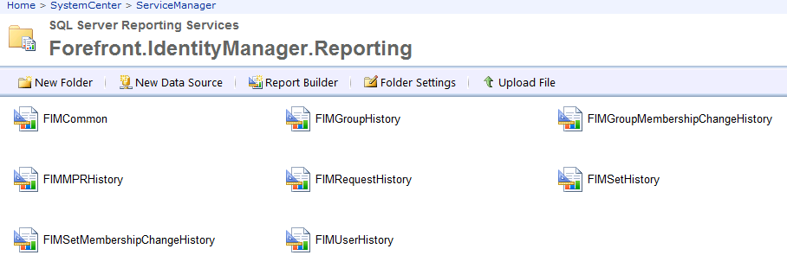
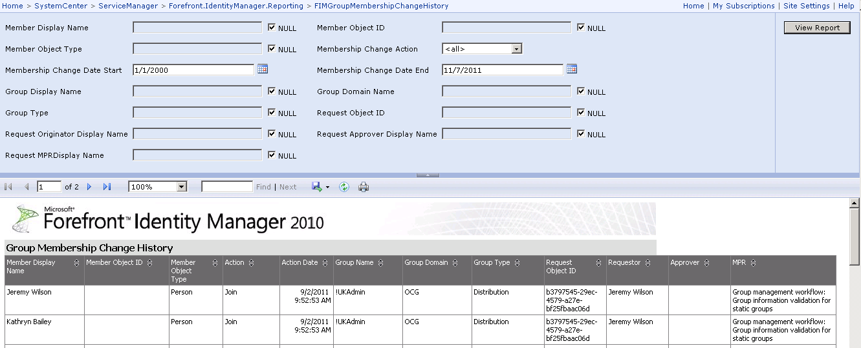
FIM2010 R2 Reporting Module What can it do for me?

Slide 6
FIM2010 R2 Reporting Module What do I need?
SQL Server Reporting Services
Provides Report platform
System Center Service Manager 2010
Provides Data Warehouse
New FIM Resource Types
Configuration of reporting process
SCSM
SSRS
Config
Config
FIM DB
DW
Report
Data
Data

Slide 7
FIM2010 R2 Reporting Module How does it work?
FIM
Report Log:
Change
Change
Change
Change
Change
…
Incoming
Requests
1
Reporting Job
2
Service Manager
Staging and Config
Data Repository
3
Data Mart
Extract
Transform
Load

Slide 8
FIM2010 R2 Reporting Module
Demo Time

Slide 9
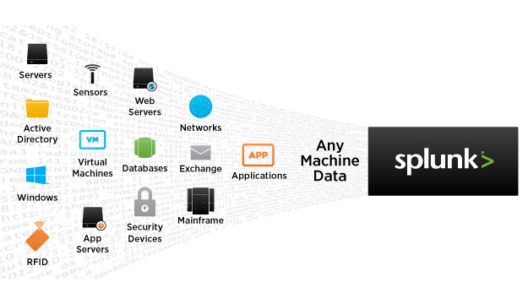
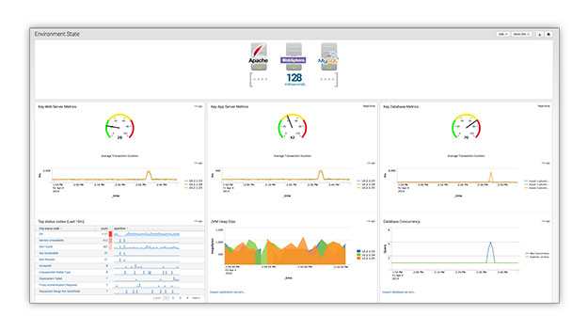
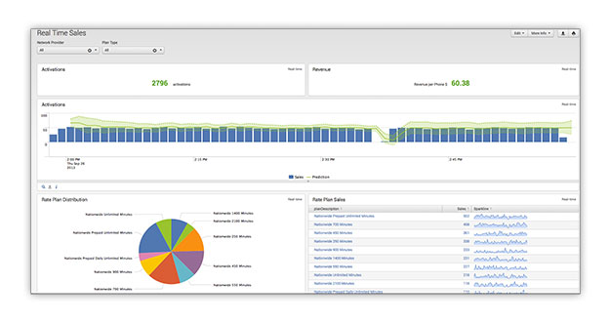
Splunk & OCG’s Splunk for FIM app What is Splunk?
Splunk Enterprise is the industry-leading platform for operational intelligence
Index any data
Search and Investigate
Interact with Search Results
Correlate Complex Events
Monitor and Alert
Report and Analyze
Splunk Apps

Slide 10
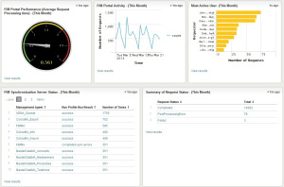
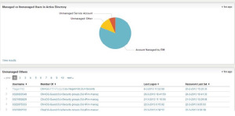
Splunk & OCG’s Splunk for FIM app Splunk and FIM?
App contains:
collecting scripts (PS)
Reports
Dashboard
Dashboard has three sections
Service Operations
Service Level
Analytics

Slide 11
Splunk & OCG’s Splunk for FIM app What do I need?
A Server
Windows 2008R2 or newer
Linux distribution
Splunk Software
Free download at splunk.com
Free edition allows 500MB indexed data per day
Enterprise Edition Licenses are per quote
OCG’s Splunk for FIM app
Free download from splunkbase
Patience and Time
Don’t tell me,
SHOW me!

Slide 12
SQL Server Reporting Services Another reporting solution!
SQL Server Reporting Services
Separate server?
Database placement?
SharePoint Integrated?
Data collection
T-SQL scripts
Auditing
Triggers
Report design
Report Builder
SQL Data Tools

Slide 13
SQL Server Reporting Services How does it work?
FIM
Request Log:
Request
Request
Request
Request
Request
…
Incoming
Requests
T-SQL Job
Reporting Collection
Request Parameters
Data Repository
Reports
Extract
Transform
Load

Slide 14
SQL Server Reporting Services Data Collecting
Thanks to Carol for these scripts!
Needed some work on Parameter information
Get Requests
Loads FIM Requests from FIMServices database into FIMReporting database
Pivot New
Transforms Requests into usable data
Extract Parameters
Extracts all Parameter information
Get Details
Puts all Parameter values into separate table

Slide 15
SQL Server Reporting Services Data Reporting
DataSources
FIMService Database
FIMSynchronization Database
FIMReporting Database
Active Directory
Other
Reports
Ask the BI Expert
T-SQL Statements
Report design
Ask the SQL DBA
T-SQL Statements
Ask Jeeves

Slide 16
SQL Server Reporting Services Demo Time!

Slide 17
Question Time

Slide 18
More Information
@biggelaara
Biggelaara.wordpress.com
www.splunk.com
technet.Microsoft.com
http://technet.microsoft.com/en-us/library/jj133858%28v=ws.10%29.aspx
http://msdn.microsoft.com/en-us/library/ms159106.aspx

