Slide 1
Kent Nordström
Blog: http://konab.com
Twitter: http://twitter.com/kentnordstrom
Notes:
My name is Kent Nordström and you will find my blog at konab.com and I know many of you are already following me on Twitter.

Slide 2
Topic
Using the FIM Portal as
administrative tool
Notes:
Todays topic is about how to use the FIM Portal as administrative tool. I will focus on the things I almost always add to FIM’s configuration to make it more useful.

Slide 3
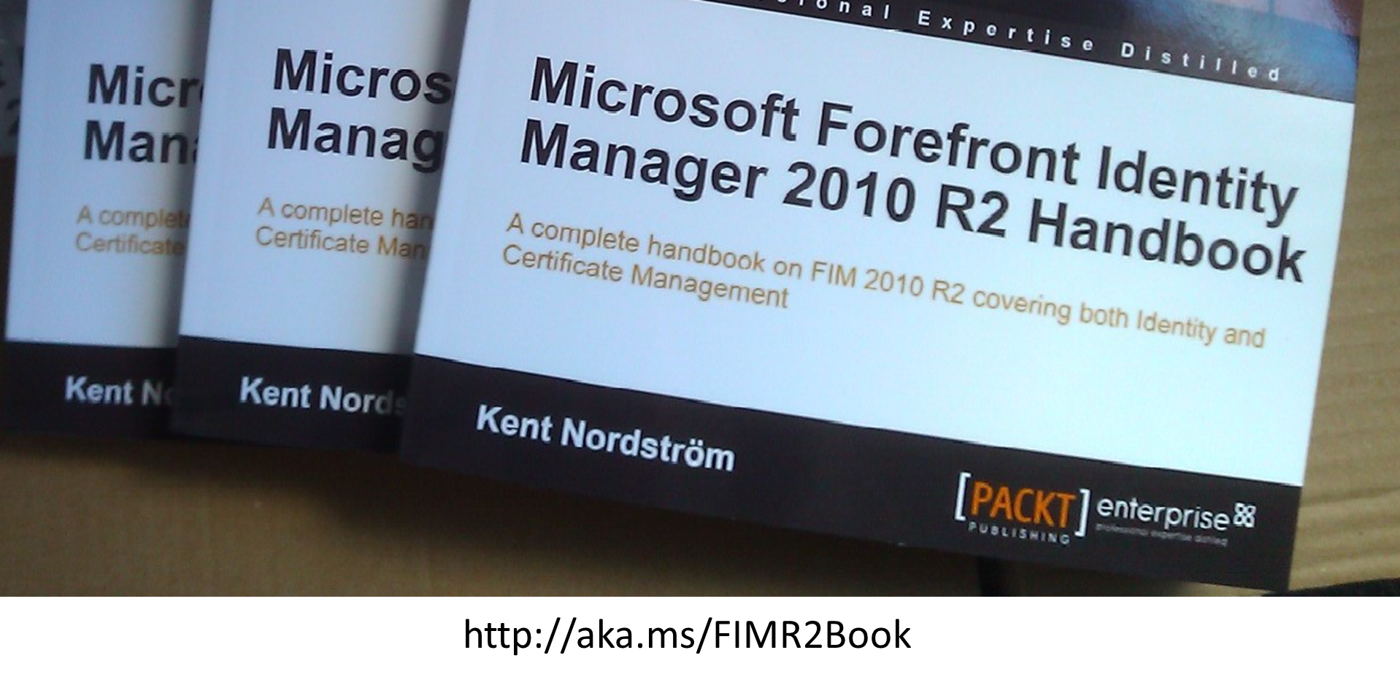
FIM 2010 R2 Handbook
Notes:
In 2012 I released the FIM 2010 R2 handbook. If you have read it you already know that this book is very much about how to build FIM 2010 R2 solutions as codeless as possible.

Slide 4
FIM 2010 R2 Video
http://konab.com/fim-2010-r2-video/
Notes:
In July 2014 I released the FIM 2010 R2 Video course. 2 ½ hours of FIM spread into 36 videos covering a complete FIM implementation.

Slide 5
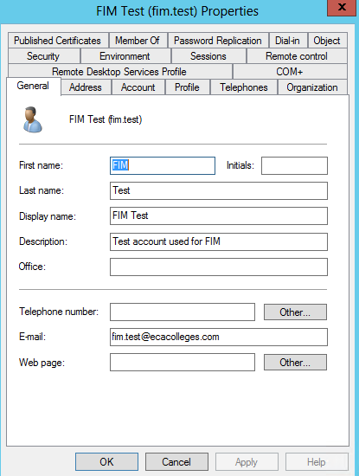
Users and Computers
Notes:
One the crappiest tools you can use for managing users is the Users and Computers tool that comes in Windows.

Slide 6
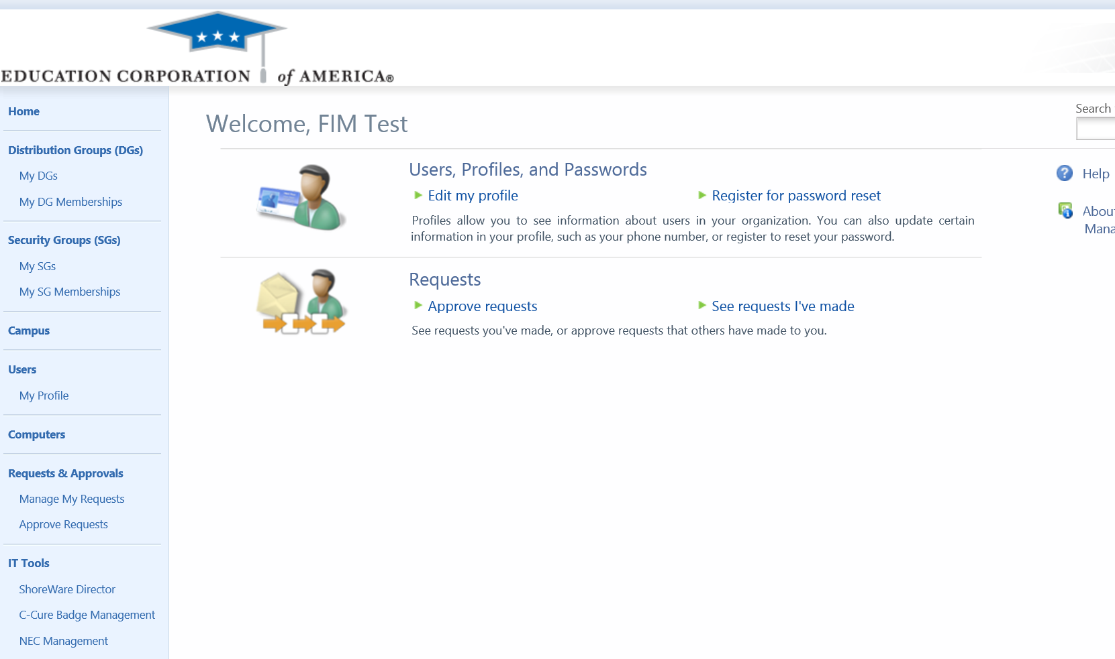
FIM Portal
Notes:
The FIM Portal can be used to replace many current solutions and also to merge different admin tools into one.

Slide 7
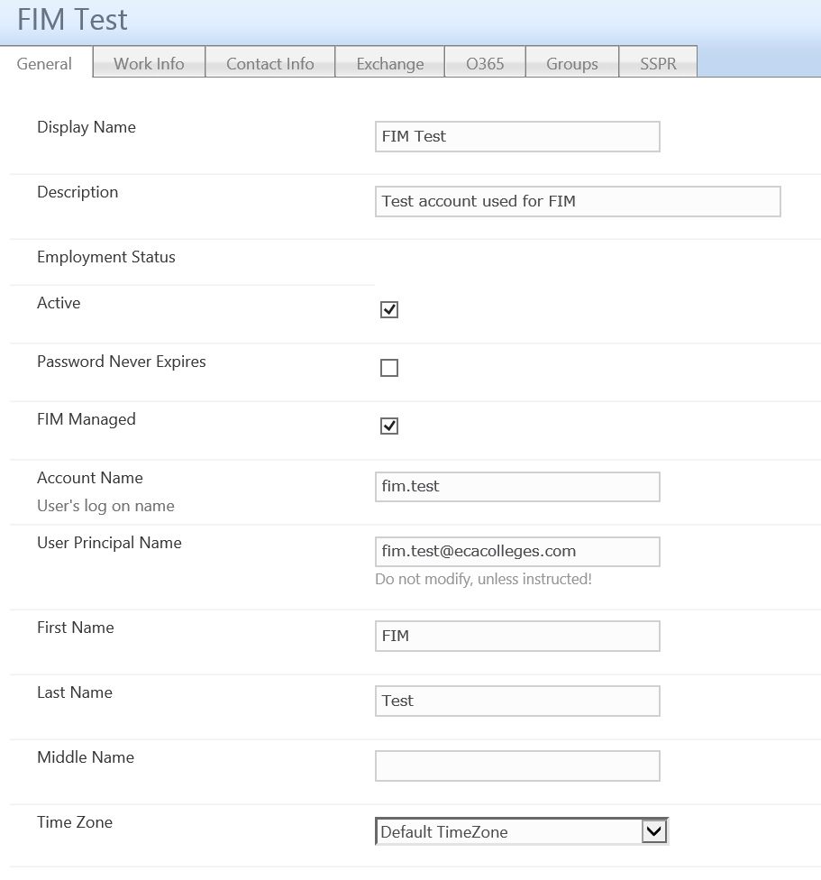
FIM Portal – Edit User
Notes:
In the FIM Portal the UI is ”dynamic” from a security perspective. Controls are hidden or readonly automagically based on permissions. Building your own management UI with the same level of authorization control, you have in the FIM portal, is not easy.

Slide 8
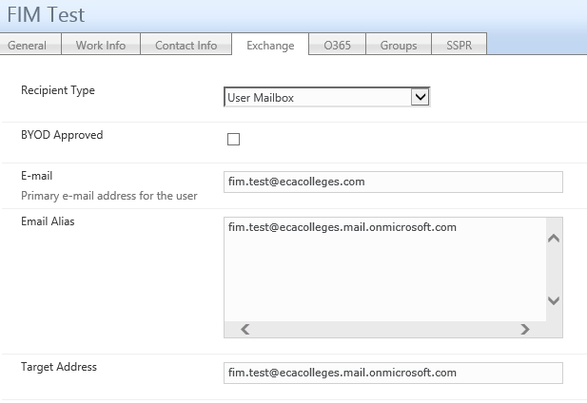
Replace multiple tools
Notes:
In the same tool we can also replace multiple management tools like Exchange Control Panel or…

Slide 9
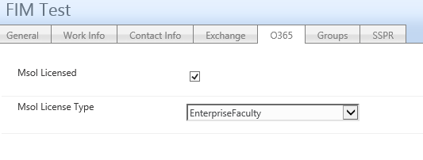
O365 Licenses
Notes:
managing O365 settings. The idea is to make all ”common” administrative tasks available through the FIM Portal UI.

Slide 10
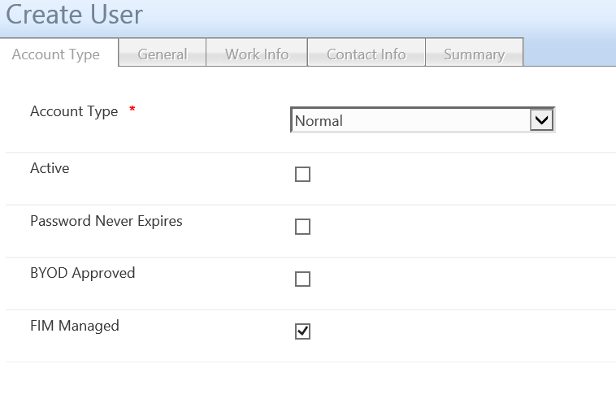
FIM Portal – Create User
Notes:
When creating a new user in the FIM Portal we should minimize the amount of information required and trying to avoid text controls as muchg as possible.

Slide 11
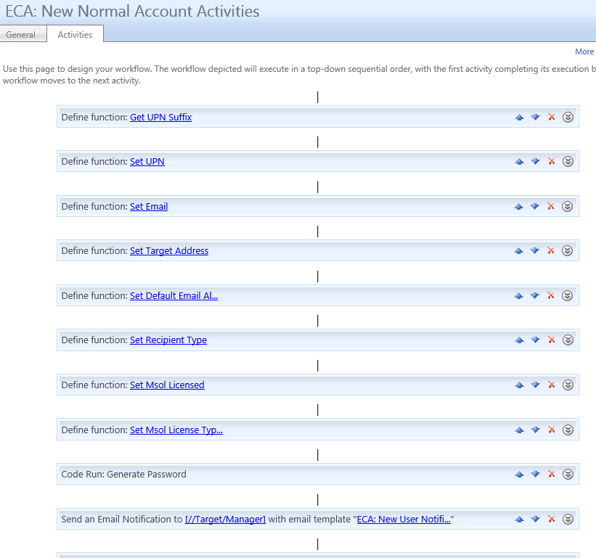
Serialize WFs – Avoid locks
Notes:
Just a reminder when it comes to creating users in the FIM Portal. SQL locks are common when a lot of WF’s fire when a new user is created. Try to serialize them to avoid the locks.

Slide 12
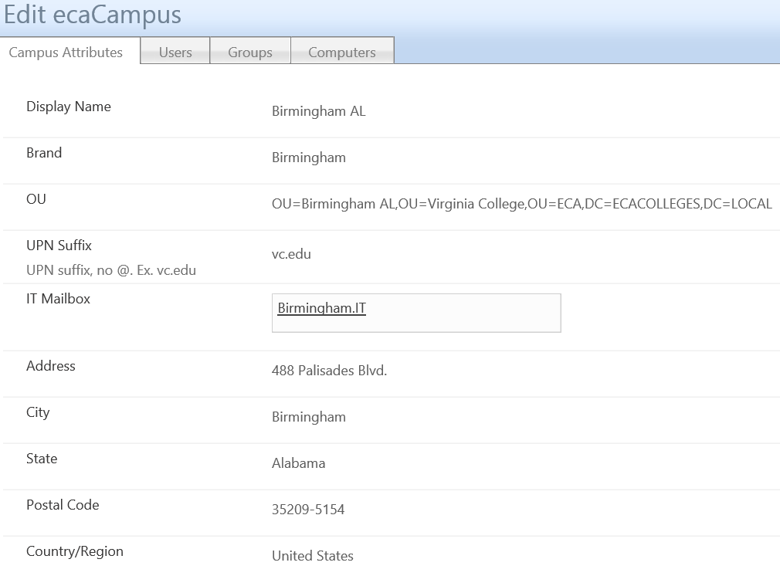
”Parent” Object
Notes:
I always try to implement some kind of parent object or objects that can hold the common settings for many objects. These settings can then be inherited down to the child objects. In most customer cases the main parent object is the organizational unit we get from some HR system. But In the examples today I will show other parent objects customers are using.

Slide 13
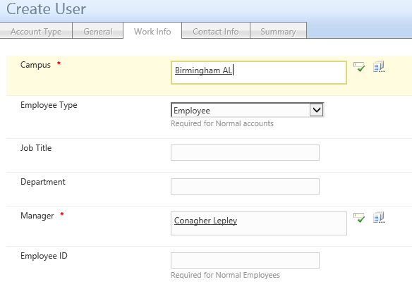
Inherit from ”parent”
Notes:
By using the inherit method the amount of information required to be managed can be reduced.

Slide 14
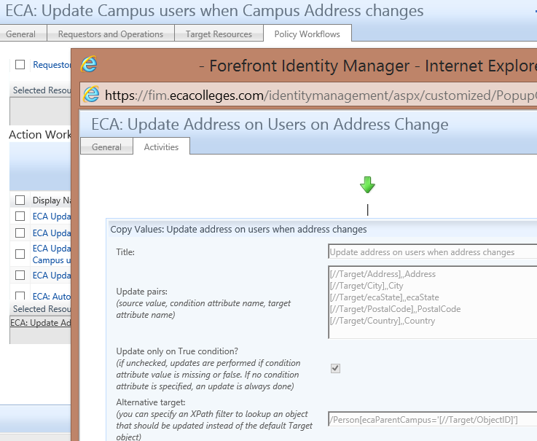
“Inheritance” update WF
Notes:
The use of the parent object typically also require some WF to update the child objects when parent is updated. Here I use Soren’s Copy Values activity from his CodePlex WorkFlow Library.

Slide 15
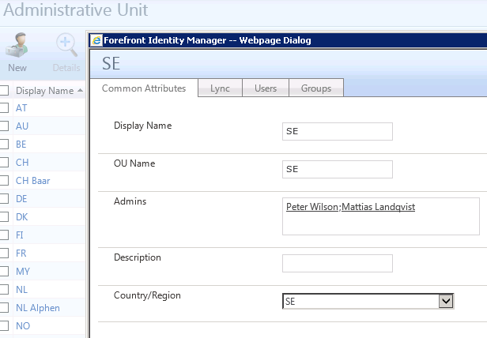
”Delegated” Administration
Notes:
I also have customers where the parent object is used for advanced delegations. By defining the Admins on the parent object I avoid having to create a lot of MPRs.

Slide 16
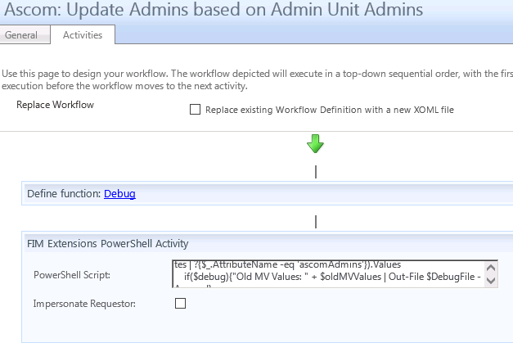
The MultiValue problem
Notes:
The problem with the Admins is that it’s MultiValue and modifying MultiValue reference values is not easy. I have only found that the PowerShell WF activity solves it for me at the moment.

Slide 17
Coming soon… or?
Notes:
Hopefully Sorens next version is coming soon to allow easier management of MultiValue attributes.

Slide 18
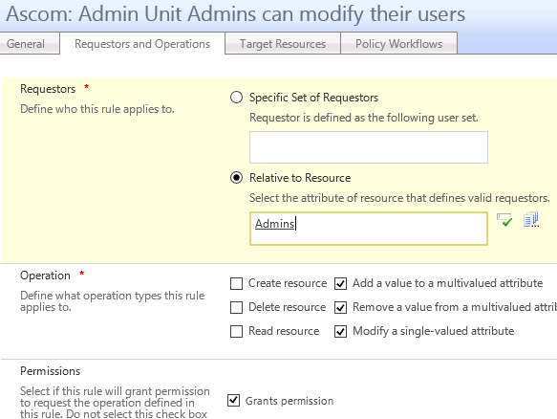
Only ONE MPR!
Notes:
Inheriting the Admins from the Parent object gives the big benifit of only having ONE MPR to allow Admins to manage their objects in this case where administration is split into 20+ admin units.

Slide 19
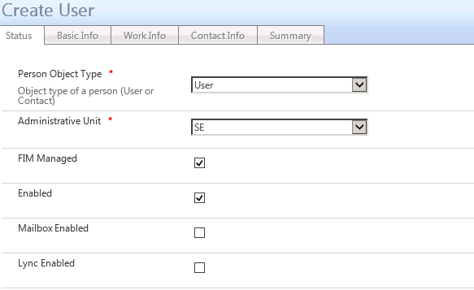
”Dynamic” RCDC
Notes:
RCDC’s are, as we all know, NOT dynamic in their nature. To make them kind of dynamic we need to make some tricks. The most common one is to use boolean values to control the visibility of groupings and controls.

Slide 20
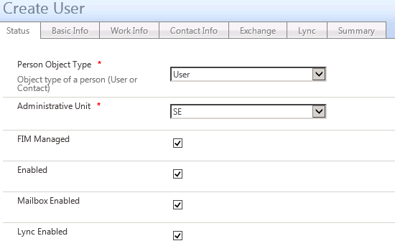
Booleans controlling UI
Notes:
So if I check the Mailbox and/or Lync checkbox the groupings (or tabs) get’s visible.

Slide 21
RCDC – Dynamic Tab/Control
Notes:
There are plenty of exampels on how to do this, but I add this slide for reference on how it’s done. The key to make it dynamic is the AutoPostback=true on the boolean controlling the visibility. The grouping or control you want hide/show can then use this boolean as the value for Visible. If you use this in the Create RCDC you must remember to always have the DefaultValue configured.

Slide 22
Don’t chain dynamic controls
A ”dynamic” Grouping
cannot contain
a ”dynamic” Control!
Notes:
As far as I have found it’s not possible to chain this usage of boolean flags to control the visibility of tabs and controls. If you have a ”hidden” tab that in itself contains a control where the visibility is controlled by some other boolean value. You will get an RCDC rendering error.

Slide 23
UocSearchDataSource
Notes:
Another addon to the default UI is the somewhat undocumented UocSearchDataSource you can add to your RCDC’s. This can really have a great impact on the usability of the FIM Portal.

Slide 24
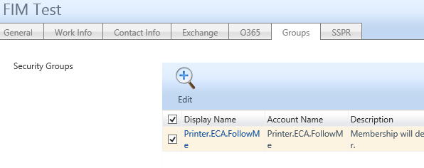
Reference Search
Notes:
A common usage of the search datasource is to show reference searches like the groups tab on a user to show member of. But it can also be used to show child objects on the parent object as you saw earlier to make finding and administering objects easier.

Slide 25
Summary
“Kent’s Best Practices”
“Parent” object
Inheritance when possible
Booleans for basic UI control
UocSearchDataSource
Reference searches for backlinks in UI
Questions?
Notes:
To summarize my rules of thumbs… I use …
Parent objects to reduce the amount of information required to manage on each object.
Booleans for basic dynamic RCDC control
Always add the UocSearchDataSource to your RCDC’s
This was all I planned for today.
Hopefully I have showed you that the FIM Portal is actually quite easy to make useful even with just the built-in functionality in FIM.

